Slide 1

Red Hat Satellite
6.6 Master Slide Deck
Presenter’s Name
Title
Presenter’s Name
Title

Slide 2
This slide deck is not meant to be used as a whole.
Create your own copy by clicking: File > Make a copy
Then delete any slides you don’t need.
We’ll try to keep the slides in a logical order, but there will certainly be some overlap in the deck as we add more in depth materials
If you have feedback or slides to contribute, please make a comment in the deck or email:
satellite@redhat.com
HOW TO USE THIS SLIDE DECK

Slide 3
Red Hat Satellite is a scalable platform to manage patching, provisioning, and subscription management of your Red Hat infrastructure, regardless of where it is running.
Red Hat Satellite

Slide 4
Real World Challenges
Red Hat Satellite

Slide 5



Red Hat Satellite
How do you currently manage your IT environment?
Do your processes scale?
Are you confident you can quickly respond?
Are your systems compliant?
Notes:
It's important for customers to have a systematic way to manage their infrastructure. Without standard processes, their organization could at best have inefficiencies, and at worst be open to all kinds of security breaches, compliance issues, and audit difficulties.
So help them think about how they currently manage their environment.
Are they confident they can respond quickly to the next zero-day vulnerability?
Do they believe that the people and processes they have in place are built to scale? Can those same people and processes keep up with the changing needs of the business? Customers often spend a lot of money to get great talent. Do they want that talent spending their time doing menial tasks that could be automated? Imagine the impact those resources could make if they had more bandwidth to be deployed on other strategic projects.
Finally, most organizations face some kind of compliance requirements – whether that's industry-mandated compliance or simply compliance with internal regulations. Ask your customers how they handle that today and it could open up a valuable dialog.

Slide 6
Red Hat Satellite
Red Hat Satellite can help
Do your processes scale?
Are you confident you can quickly respond?
Are your systems compliant?
Increase efficiency
Address security easily
Audit and remediate systems
Notes:
Let's look at how Satellite can help.
Red Hat Satellite lets their organization easily address security, bug-fix, and enhancement errata. For example, you can use it to identify and quickly respond to vulnerabilities like Shellshock, Heartbleed, and GHOST. One of our customers in Europe heard about Shellshock and was able to patch thousands of systems in minutes -- finishing right before his boss called in a panic to tell him about the bug he’d just heard about.
Related to scalability, Red Hat Satellite automates workflows and streamlines content management. This makes administrators much more efficient, and enables them to have time to work on strategic initiatives rather than spending all day on tedious, Manual error-prone tasks.
Red Hat Satellite also gives customers peace of mind related to compliance. As an example, if a customer is mandated to have systems compliant with,PCI, you must make sure the systems are configured and stay configured in a secure manner. We built industry-standard scanning and remediation tools, such as OpenSCAP, into Satellite to help you audit systems and remediate them if required

Slide 7
Introduction to Satellite
Red Hat Satellite

Slide 8




Red Hat Satellite
Why Red Hat Satellite?
Manage Red Hat® infrastructure
Streamlined content management
Developed to scale
Simplified system integration
Enhanced drift and configuration management
Notes:
Manage more than just RHEL. Red Hat Satellite provides Lifecycle management across your RH infrastructure. For example, Satellite can be used to deploy RHV hypervisors and configure them. For customers using only Red Hat Enterprise Linux today, as you adopt more RH infrastructure, you will want to bring the same process lifecycle management to those platforms
Streamlined content management. Based on 12+ years of customer feedback, we simplified workflows based on the most common patterns of use to streamline the user experience.
Built to scale. The evolution of the Proxy concept in Satellite 5, Satellite Capsule Servers distribute CPU-intensive operations closer to the systems managed, improving performance in a more secure environment.
Simplified system integration Leverages existing resources, including services for identity management (AD, LDAP, Red Hat IdM) and services for provisioning and configuration (VMWare, RHV, OpenStack, KVM, Amazon EC2, Google Compute Engine, RackSpace)
Enhanced drift and system configuration
Simplifies configuration from initial provisioning until eventual retirement
Provides ability to detect, report and remediate changes to defined state of managed systems

Slide 9
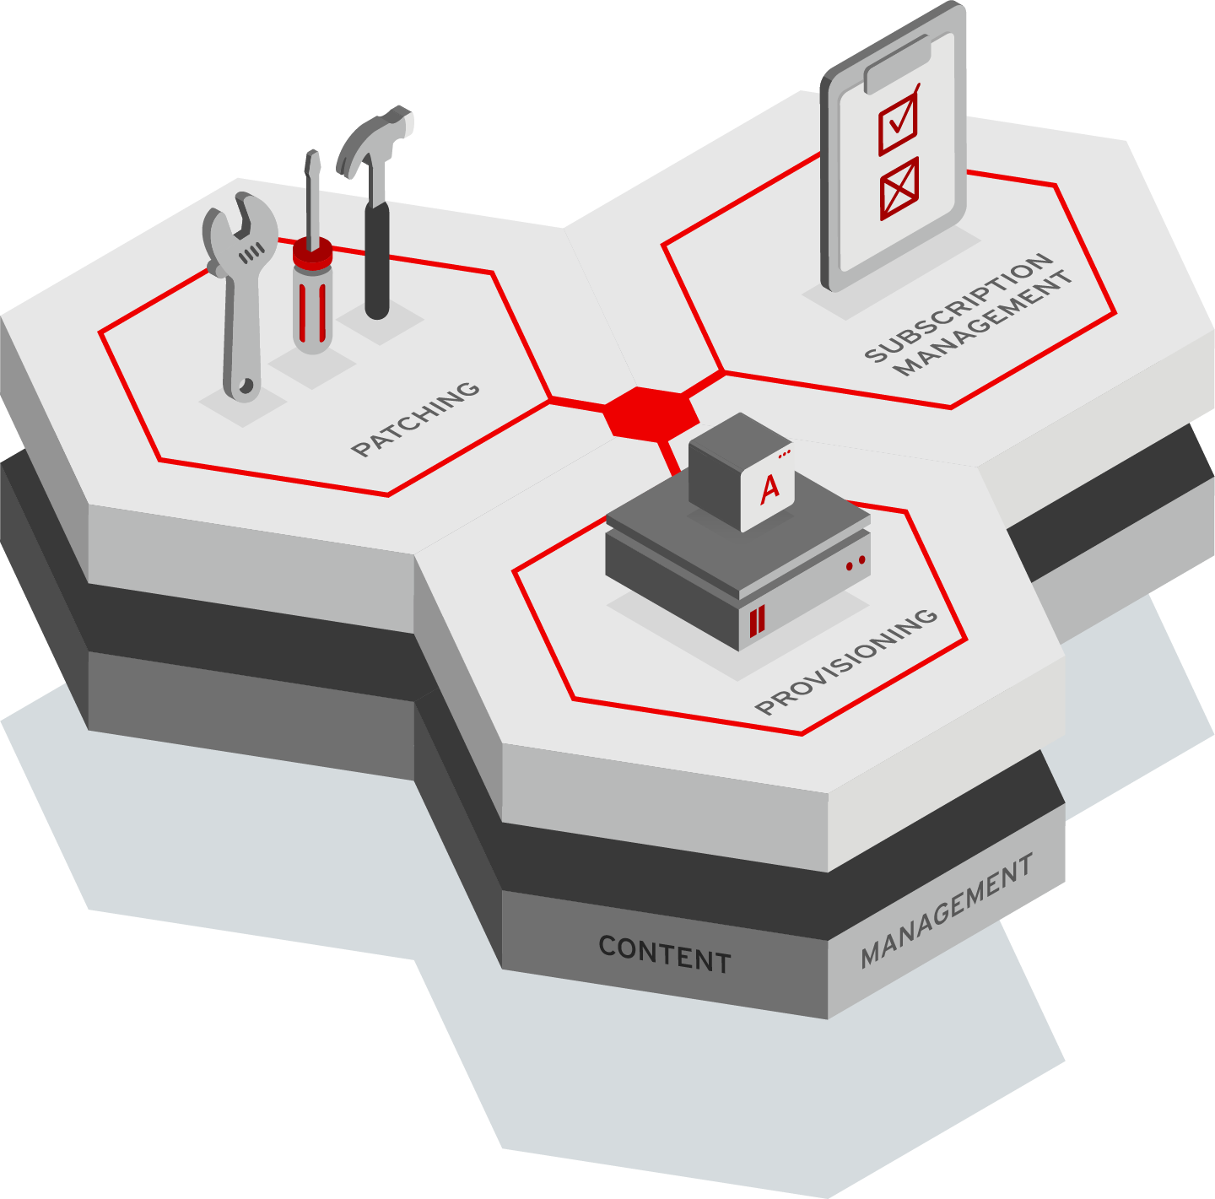


Red Hat Satellite
Notes:
NOTE TO SPEAKER: If you are working with an experienced Satellite customer then you can skip breakout slides below and only show this slide.
If presenting all slides:
In addition to the four primary use cases we discussed, Satellite also has many other capabilities that are critical to our customers.
These include but are not limited to features like
Security compliance through OpenSCAP
The ability to have multi users, each with their own roles and responsibilities with Satellite, enabling multi-tenancy
Built in auditing and reporting capabilities which vary depending on the specific item that you want to audit or report on
And predictive analytics enabled through Red Hat Insights.
If presenting this slide as a standalone suggested speaker notes:
Red Hat Satellite is a scalable platform to manage patching, provisioning, and subscription management of your Red Hat infrastructure.
On screen you see the Satellite coat of arms which in the center captures the four primary use cases for Satellite.
Patching and software management simplifies the process of managing hundreds or thousands of systems, enabling you to easily patch security vulnerabilities or deploy custom packages to your content hosts.
Subscriptions can be easily managed and tracked across your enterprise
Provisioning of servers can be simplified using profiles and new hosts can be quickly discovered, reducing the overall time it takes to provision new systems
And centralized configuration management can be used to detect and remediate drift and enable a standard operating environment.
Satellite has many additional capabilities such as integration with Red Hat Insights for predictive analytics and security compliance through OpenSCAP.

Slide 10
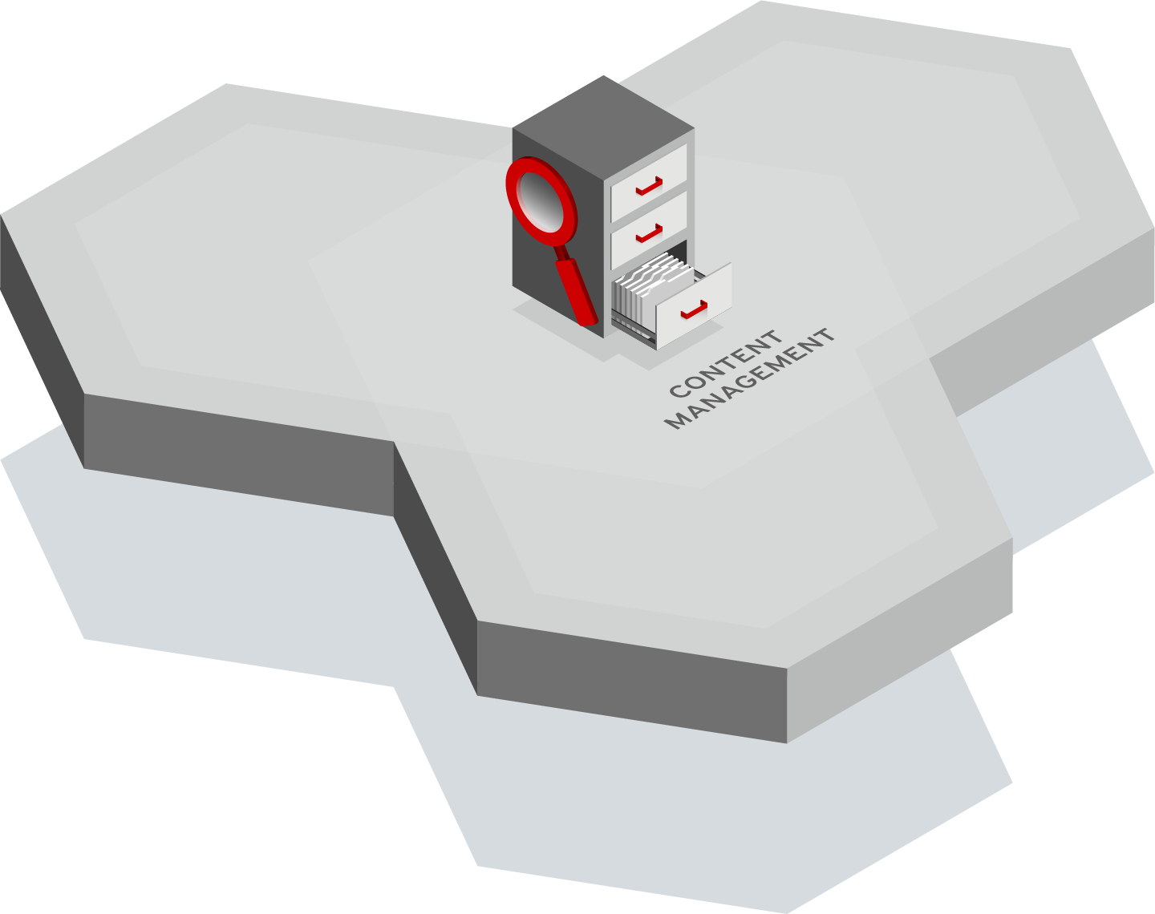



Content Management
Red Hat Satellite
Content Repository any type of content made available to any host
Curation of content prior to distribution
Distribution of content as close as possible to the end point.
Notes:
Get and curate all the content.
Then you do creative things with it like provision and patch
ANY content type - Multiple content types - RPMs, ISOs, Binary, Container; Red Hat of third party
Powerful controls around the curation of content (CVs)
Federation of content - put as close to the end point as possible (using capsule servers)
Curation is being able to take an approved subset of the content and make it available.
If you have access to ALL RHEL content, you can make ONLY the security content available to hosts.
Federate content delivery as environments scale., IT has many workloads running (possibly around the world), which can lead to bandwidth issues. Satellite provides Capsule server that enable users to take all that content already organized and curated for their systems and put it as close to those systems as possible.
Why Federate? 1. Saves cost. Remote data centers may be charged by amount of data. 2. Saves time. If numerous systems are in a remote data center, it's much easier to get that content locally. 3. Helps meet SLAs -- new systems can be provisioned/patched locally.

Slide 11
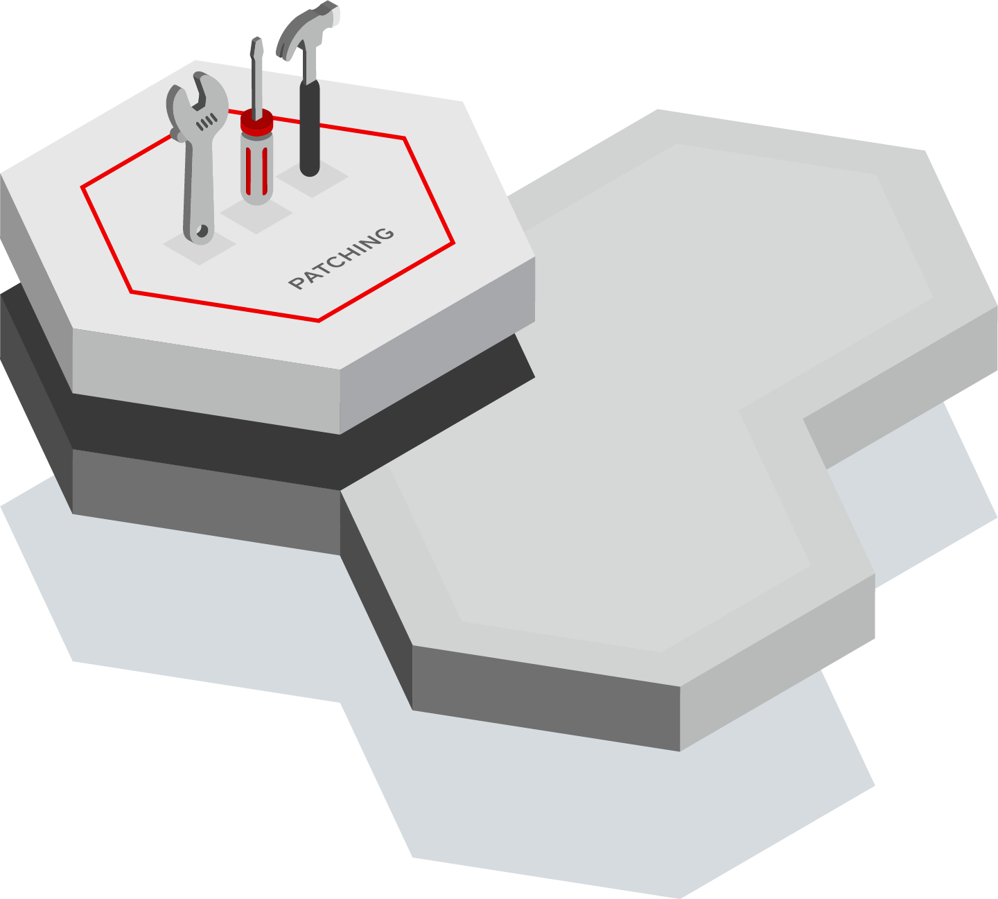



Patch Management
Red Hat Satellite
Report on hosts that need updates, fixes, or enhancements
Group homogeneous systems so that you can easily work with them
Respond quickly to patching requirements using scalable automation
Notes:
ID and reporting phase - I need to know what systems in the environment are vulnerable.
I also need to know what systems have had patches already installed.
1st thing is reporting
Using Ansible and remote execution you can patch ALL of the systems in your environment quickly and easily. If you need to patch 50,000 systems at the click of a button you can do it with Satellite.
Group homogeneous systems so that you can easily work with them in subsets
----------
Define SOE
Satellite helps users define and maintain a Standard Operating Environment (SOE). Building an SOE includes 2 key things….
1. Defining your builds, workloads, apps, etc that run on Red Hat
2. Figuring out how to best manage and integrate those in your organization by looking at the enterprise -- from workloads to people who manage to patching methodologies, etc-- so that when it's time to build out new servers, etc, you have tools, processes in place to quickly create those.
Quickly respond to security vulnerabilities (Heartbleed/ ShellShock) Once an SOE is built, you have the means to quickly, efficiently and securely make changes. With Satellite and an SOE in place, changes are minimally invasive because all the hard work is done. Systems still need to be patched (and quickly), because the amount of time from a vulnerability being announced to that vulnerability being exploited is getting smaller and smaller.
Comply with your organization's security policies Once you define and categorize systems based on roles and profiles, it's much simpler to put methodologies in place to ensure security. Satellite provides complete control over what content is made available. For example, an organization's business-critical CRM system might get patched only for security. While web servers running other apps get kept as fresh as possible with enhancements, bug fixes, etc. Satellite (with the Environments and Content Views feature) can do both
Deploy all Red Hat Infrastructure as well as third-party software The ability to apply Red Hat and non-Red Hat software means that a user can put all those software bits in Satellite and it can be deployed. Once Satellite has that content, it "owns" it and Satellite keeps track of it, improving security and ensuring better tracking of what is deployed on each system.

Slide 12
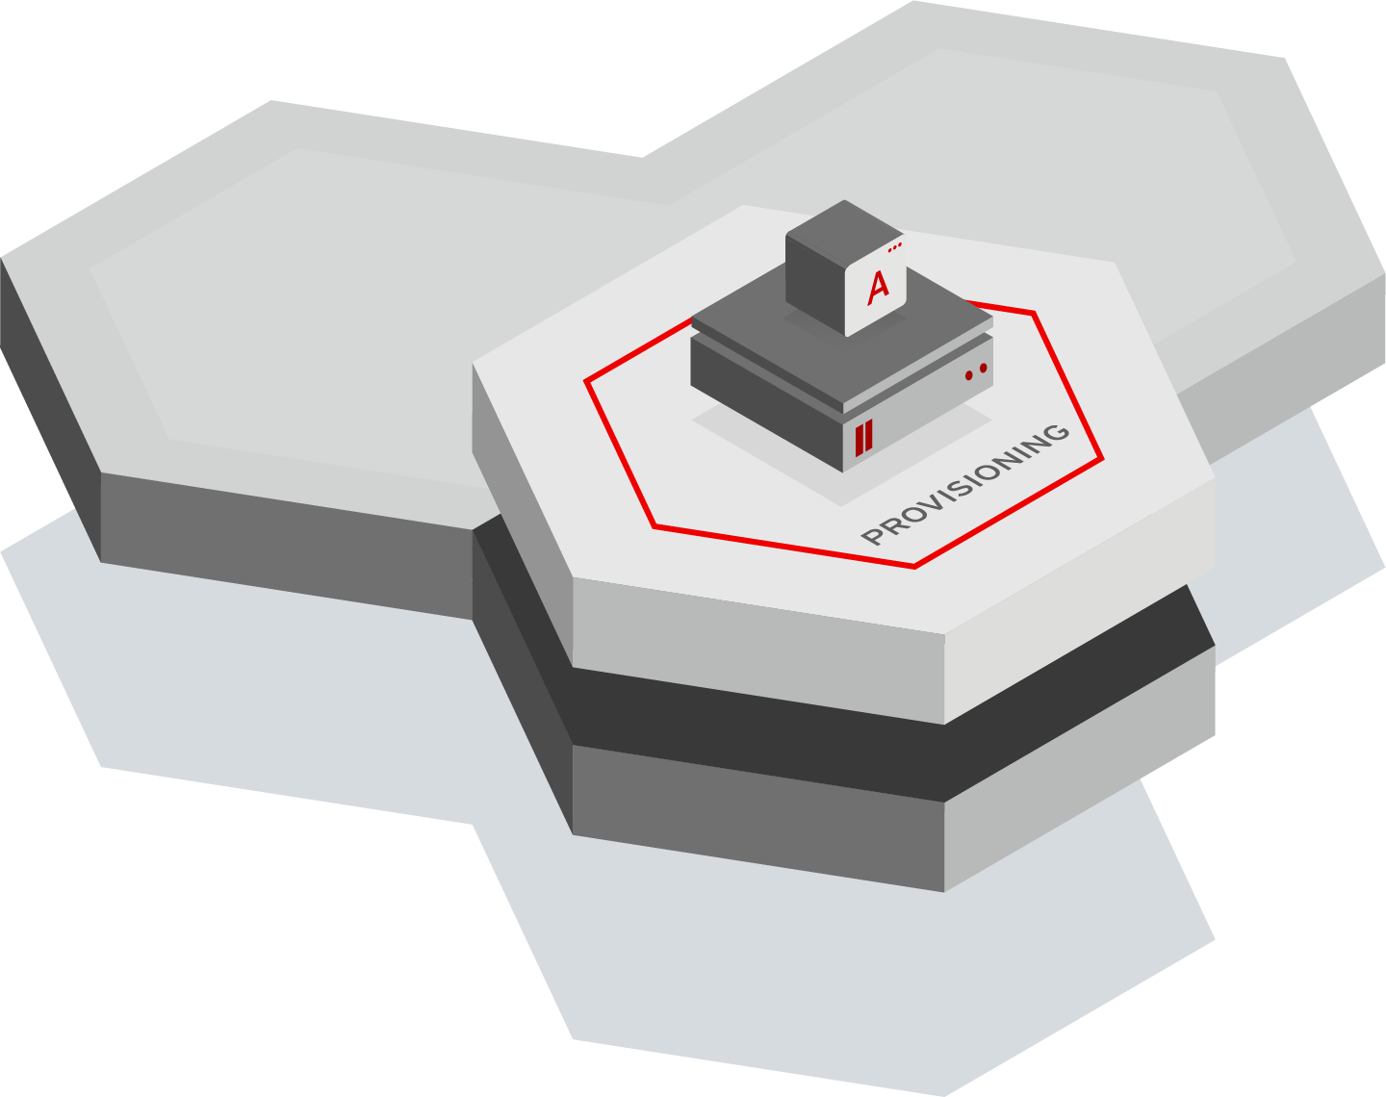

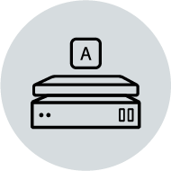
Provisioning Management
Red Hat Satellite
Provision to bare metal, virtual, private, and public clouds
Import non-provisioned hosts
Automate using Ansible roles to perform post-provisioning steps
Notes:
Provision to bare metal, virtual, private, and public clouds Most organizations have some mix of bare metal, virtual and cloud environments. Satellite allows users to connect to all of these and give the ability to create VMs, virtual instances in clouds, power on bare metal machines, etc . Satellite has the ability to integrate into existing infrastructure services like DNS, DHCP, and identity platforms, automating what normally would mean a multi-step process
Import non-provisioned hosts Discovery is a means to setup the networking infrastructure so that when new systems are brought in, you can simply turn them on and those servers will show up in Satellite as new systems to manage.
Automate

Slide 13




Subscription Management
Red Hat Satellite
Centrally manage subscription usage
Maintain accurate inventory and utilization information
Report on subscription consumption
Notes:
Most enterprises know that they must keep track of all their software and hardware assets. Satellite collects a large number of facts about systems (server hardware inventory, date brought online, decommission date, etc), giving users one place to look for inventory and utilization information.
Satellite can also track hardware and other assets and report on consumption.
Report on subscription consumption on a group-by-group
Given the subscriptions that you have purchased from RH, this is the consumption of those subscriptions. You are using 92 of 100 RHEL.
In a multi-org Satellite I can report on a specific organization or on any arbitrary subset.
For ORG 1&2 show me all systems that have RHV in their subscriptions.
Show me all systems that are greater than 2 sockets and use a RHEL subscription.

Slide 14

Additional Satellite Capabilities
Red Hat Satellite
Configuration Management using Ansible or Puppet
Automation through integration with Ansible Tower
Compliance using OpenSCAP policies
Notes:
Additional capabilities that help to differentiate Satellite
---
System configuration in Satellite enables users to define desired state of systems. By leveraging declarative technology, we enable users to tell Satellite the desired end state, and Satellite figures out best way to get there. This means that administrators don't have to write scripts for each action. Satellite understands which tools to use based on the IT environment. It can also be used to manage and make changes and create new desired states.

Slide 15
Standard Operating Environment hosts are the same across your environment
Reliable and Resilient Using Red Hat Insights
Secure your systems are patched, up to date, and compliant with security policies
Confidence in your subscription utilization
Notes:
Outcomes slide
Maintain a Standard Operating Environment through standardizing and automating your Patching and Provisioning in Satellite
Reliable and resilient
Compliant
Confidence
Secure - Vulnerabilities, Patching, & OpenSCAP
Confidence that your deployment of workloads is in accordance with what you have purchased. Knowledge of if you are over or under deployed
NOTE TO SPEAKER: If you are working with an experienced Satellite customer then you can skip breakout slides below and only show this slide.
If presenting all slides:
In addition to the four primary use cases we discussed, Satellite also has many other capabilities that are critical to our customers.
These include but are not limited to features like
Security compliance through OpenSCAP
The ability to have multi users, each with their own roles and responsibilities with Satellite, enabling multi-tenancy
Built in auditing and reporting capabilities which vary depending on the specific item that you want to audit or report on
And predictive analytics enabled through Red Hat Insights.
If presenting this slide as a standalone suggested speaker notes:
Red Hat Satellite is a scalable platform to manage patching, provisioning, and subscription management of your Red Hat infrastructure.
On screen you see the Satellite coat of arms which in the center captures the four primary use cases for Satellite.
Patching and software management simplifies the process of managing hundreds or thousands of systems, enabling you to easily patch security vulnerabilities or deploy custom packages to your content hosts.
Subscriptions can be easily managed and tracked across your enterprise
Provisioning of servers can be simplified using profiles and new hosts can be quickly discovered, reducing the overall time it takes to provision new systems
And centralized configuration management can be used to detect and remediate drift and enable a standard operating environment.
Satellite has many additional capabilities such as integration with Red Hat Insights for predictive analytics and security compliance through OpenSCAP.
--------------
• Simplifies management of content, including security errata
•Makes it easy to manage and track subscriptions
• Enables provisioning on bare metal, virtualized and cloud-based infrastructures
• Provides life-cycle management for Red Hat infrastructure
------
On screen you see the Satellite coat of arms which in the center captures the four primary use cases for Satellite.
Patching and software management simplifies the process of managing hundreds or thousands of systems, enabling you to easily patch security vulnerabilities or deploy custom packages to your content hosts.
Subscriptions can be easily managed and tracked across your enterprise
Provisioning of servers can be simplified using profiles and new hosts can be quickly discovered, reducing the overall time it takes to provision new systems
And centralized configuration management can be used to detect and remediate drift and enable a standard operating environment.

Slide 16
How to Buy Satellite
Red Hat Satellite

Slide 17



Red Hat Insights
Now included with all Red Hat Enterprise Linux subscriptions
Buy
Get
Notes:
While this doesn’t directly impact Satellite, we do want to make sure you are aware that as of Summit 2019 all RHEL subscriptions now include Red Hat Insights.
This is true for any supported version of RHEL that has access to the Red Hat Insights client - typically RHEL 6.10 and above.

Slide 18




Red Hat Smart Management
Red Hat Satellite
Cloud management services for Red Hat Enterprise Linux
+
Vulnerability
Compliance
System comparison
Notes:
To purchase Satellite you buy Red Hat Smart Management.
Smart Management includes Red Hat Satellite as well as the new cloud management services for Red Hat Enterprise Linux.
The initial services included in cloud management services for Red Hat Enterprise Linux are:
Vulnerability - which looks at all CVEs with an errata
Compliance - which looks at compliance to security policies via OpenSCAP
System Comparison - which enables you to compare a system to other systems.
More information on cloud management services for Red Hat Enterprise Linux can be found in the links below:
Smart Management OneStop: https://redhat.highspot.com/items/5cd19bffa2e3a92d2c5dc879#2
Smart Management master deck: https://docs.google.com/presentation/d/1k9IJqCNMJCCbM33v0k5sxQU_1CyKopSEIpw-2Zgjo7U/edit?usp=sharing
We also pointed out earlier that Red Hat Insights is now included with your RHEL subscription.
Prior to this Insights was included with Smart Management.
Now every RHEL customer has Insights access, including all Smart Management customers, and Smart Management customers get Satellite as well as the new cloud management services.
We’re working to continually add value to both your RHEL and your Smart Management subscriptions.

Slide 19
Management Flexibility
Offering Red Hat Management on-premises or in the cloud
Red Hat Satellite
Cloud Management Services
Full configuration control operating on premise
Addresses on-prem or disconnected environment
View hosts registered to the individual Satellite services
No requirements for resource set up and maintenance
Adopt new features faster with a software-as-a-service preference
Single view of all hosts across your RH infrastructure
Use cases: Content management, patching, configuration, subscription management, provisioning
Use cases: Vulnerability, Compliance, System Comparison
Smart Management Packaging gives access to both Satellite AND cloud management services
Notes:
Red Hat Smart Management offers you the flexibility to choose how to manage your RHEL hosts - from Red Hat Satellite located on premise in your datacenter, or from cloud management services offering management from cloud.redhat.com.
Which tool you use may depend on your specific business needs, but note that these are complementary products and you can absolutely use both at the same time.
The Smart Management packaging give access to both Satellite and cloud management services.

Slide 20
What do I get for Satellite with Smart Management?
Red Hat Satellite
Quantity 50 of SKU MCT3718 - Satellite Infrastructure Subscription
Enabling you to Scale out your Satellite deployment to best suit your needs.
Need a Satellite for Test/Dev?
Need a Capsule in the cloud?
Need load-balanced Capsules?
Need an air-gapped synchronization host?
No Problem.
As of August 1, 2019 this is true for all Smart Management customers, even ones that bought into earlier models.
Note: You must purchase one Smart Management subscription for every system managed with Satellite*
Have 1,000 systems 2-socket systems? Purchase 1,000 Smart Management subscriptions.
*Smart Management subscriptions are based on 2-socket systems, same as RHEL. A 4 socket system would require 2 Smart Management subscriptions. Talk to your sales rep for full details.
Notes:
When you purchase your Smart Management subscription you get quantity 50 of MCT3718.
This lets you consume 50 of any combination of Satellite Servers and Capsule Servers
Enabling you to add more Satellite for test or dec, add capsules in the cloud, or add load balanced capsules. Whatever you need.
50 is more than what 99% of Satellite customers need, and if you need more than that then contact your Red Hat representative
Note for rep: Enter a BU guidance ticket with some details on why your customers needs more subscriptions. The MBU may ask questions, but in general the request should be approved easily.

Slide 21
Links to related Smart Management and Insights material
INTERNAL RESOURCES SLIDE
The rest of this deck focuses on Satellite.
For Smart Management or Insights resources see:
Smart Management Master deck:
https://docs.google.com/presentation/d/1k9IJqCNMJCCbM33v0k5sxQU_1CyKopSEIpw-2Zgjo7U/edit?usp=sharing
Insights Master deck:
https://docs.google.com/presentation/d/1fassacJLiBXC0RsLXFa671XsApT-MPmDNs-RPvMulPs/edit?usp=sharing
Internal Smart Management Technical assets not otherwise captured here:
https://mojo.redhat.com/docs/DOC-1197201

Slide 22
How Satellite Works
Red Hat Satellite
Deployment Models

Slide 23


Red Hat Satellite
Red Hat Satellite components
Red Hat Satellite Server
Red Hat Capsule Server
Facilitates multitenant services
Offers on-premise repository management
Gives user and group role-based access control (RBAC)
Delivers powerful user interfaces (GUI, API, and CLI)*
Exports content to other Satellite servers
Allows scaling of your Satellite environment
Provides local content, provisioning, and integration services
Discovers new physical and virtual machines
*Graphical user interface (GUI), application program interface (API), and command line interface (CLI)
Notes:
There are two primary components for Satellite that you need to be aware of when planning a deployment.
The Satellite Server synchronizes the content from the Red Hat Customer Portal and provides life cycle management, role based access control, GUI/CLI/API access, and integrated subscription management.
The Satellite Capsule Server mirrors content from the Satellite Server to facilitate content federation across geographical locations. Host systems can pull content from the geo-located Capsule Server instead of the Satellite Server. Capsule Servers help to scale the Satellite environment as the number of managed systems increase.

Slide 24
Red Hat Satellite
Improve scalability and automation with capsule servers.
Notes:
Many things done by the Satellite Server can also be done with the Capsule.
Why would an organization use Capsules?
Savings because the workload is distributed between the Sat Server and Capsule, leading to better scalability
Quality of service. Most organizations are geographically dispersed and the Capsule allows them to bring many services as close to the client as possible, leading to better quality of service. Systems can be provisioned and patched faster and easier.
Automation….to provision a system, you often have to connect to external services. You can do that easily with the Capsule server, as they are closer to the services needed for connection
What can reside on the Capsule? All install options (on right of slide) -- turn on as many or as few as you need for your deployment.
Puppet master/certificate authority -- Puppet Master “tells” the client what to do. “I want this config file to look like this”
Content mirror -- selectively mirror content to the Capsule (based on user needs)
Provision, discover, configure
Security compliance reporting -- Capsule aggregates SCAP reports from clients and reports back to Sat Server (asynchronous)
Enrollment in identity
Remote Execution
Reverse Proxy -- enables Capsule to forward specific types of traffic to the Sat Server (Subscription Management, for example)
Power on/off -- BMC support to turn a system off/on, even without an OS

Slide 25
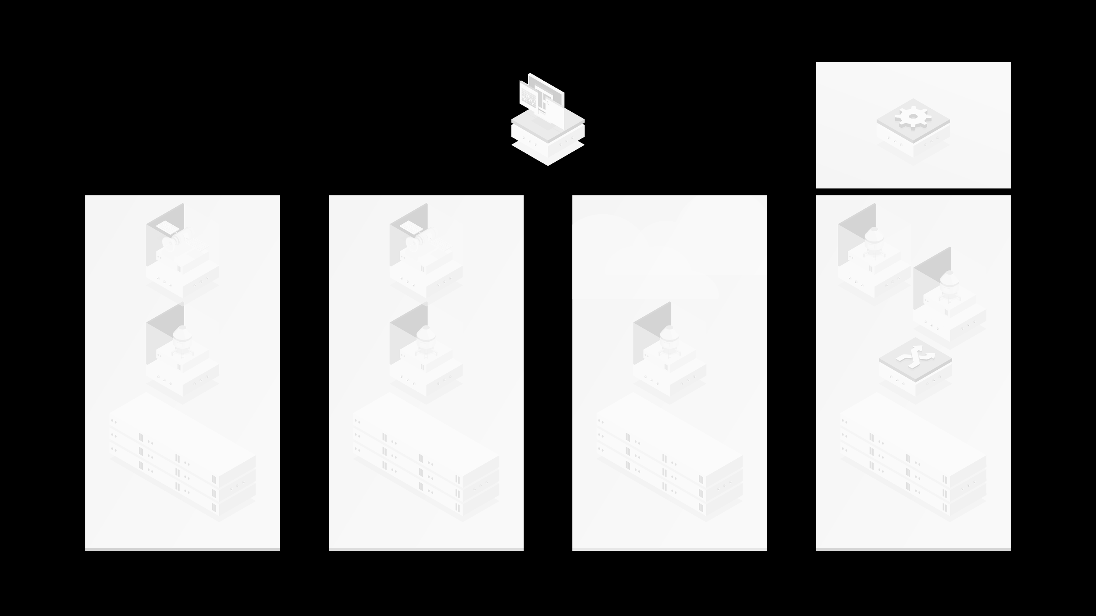
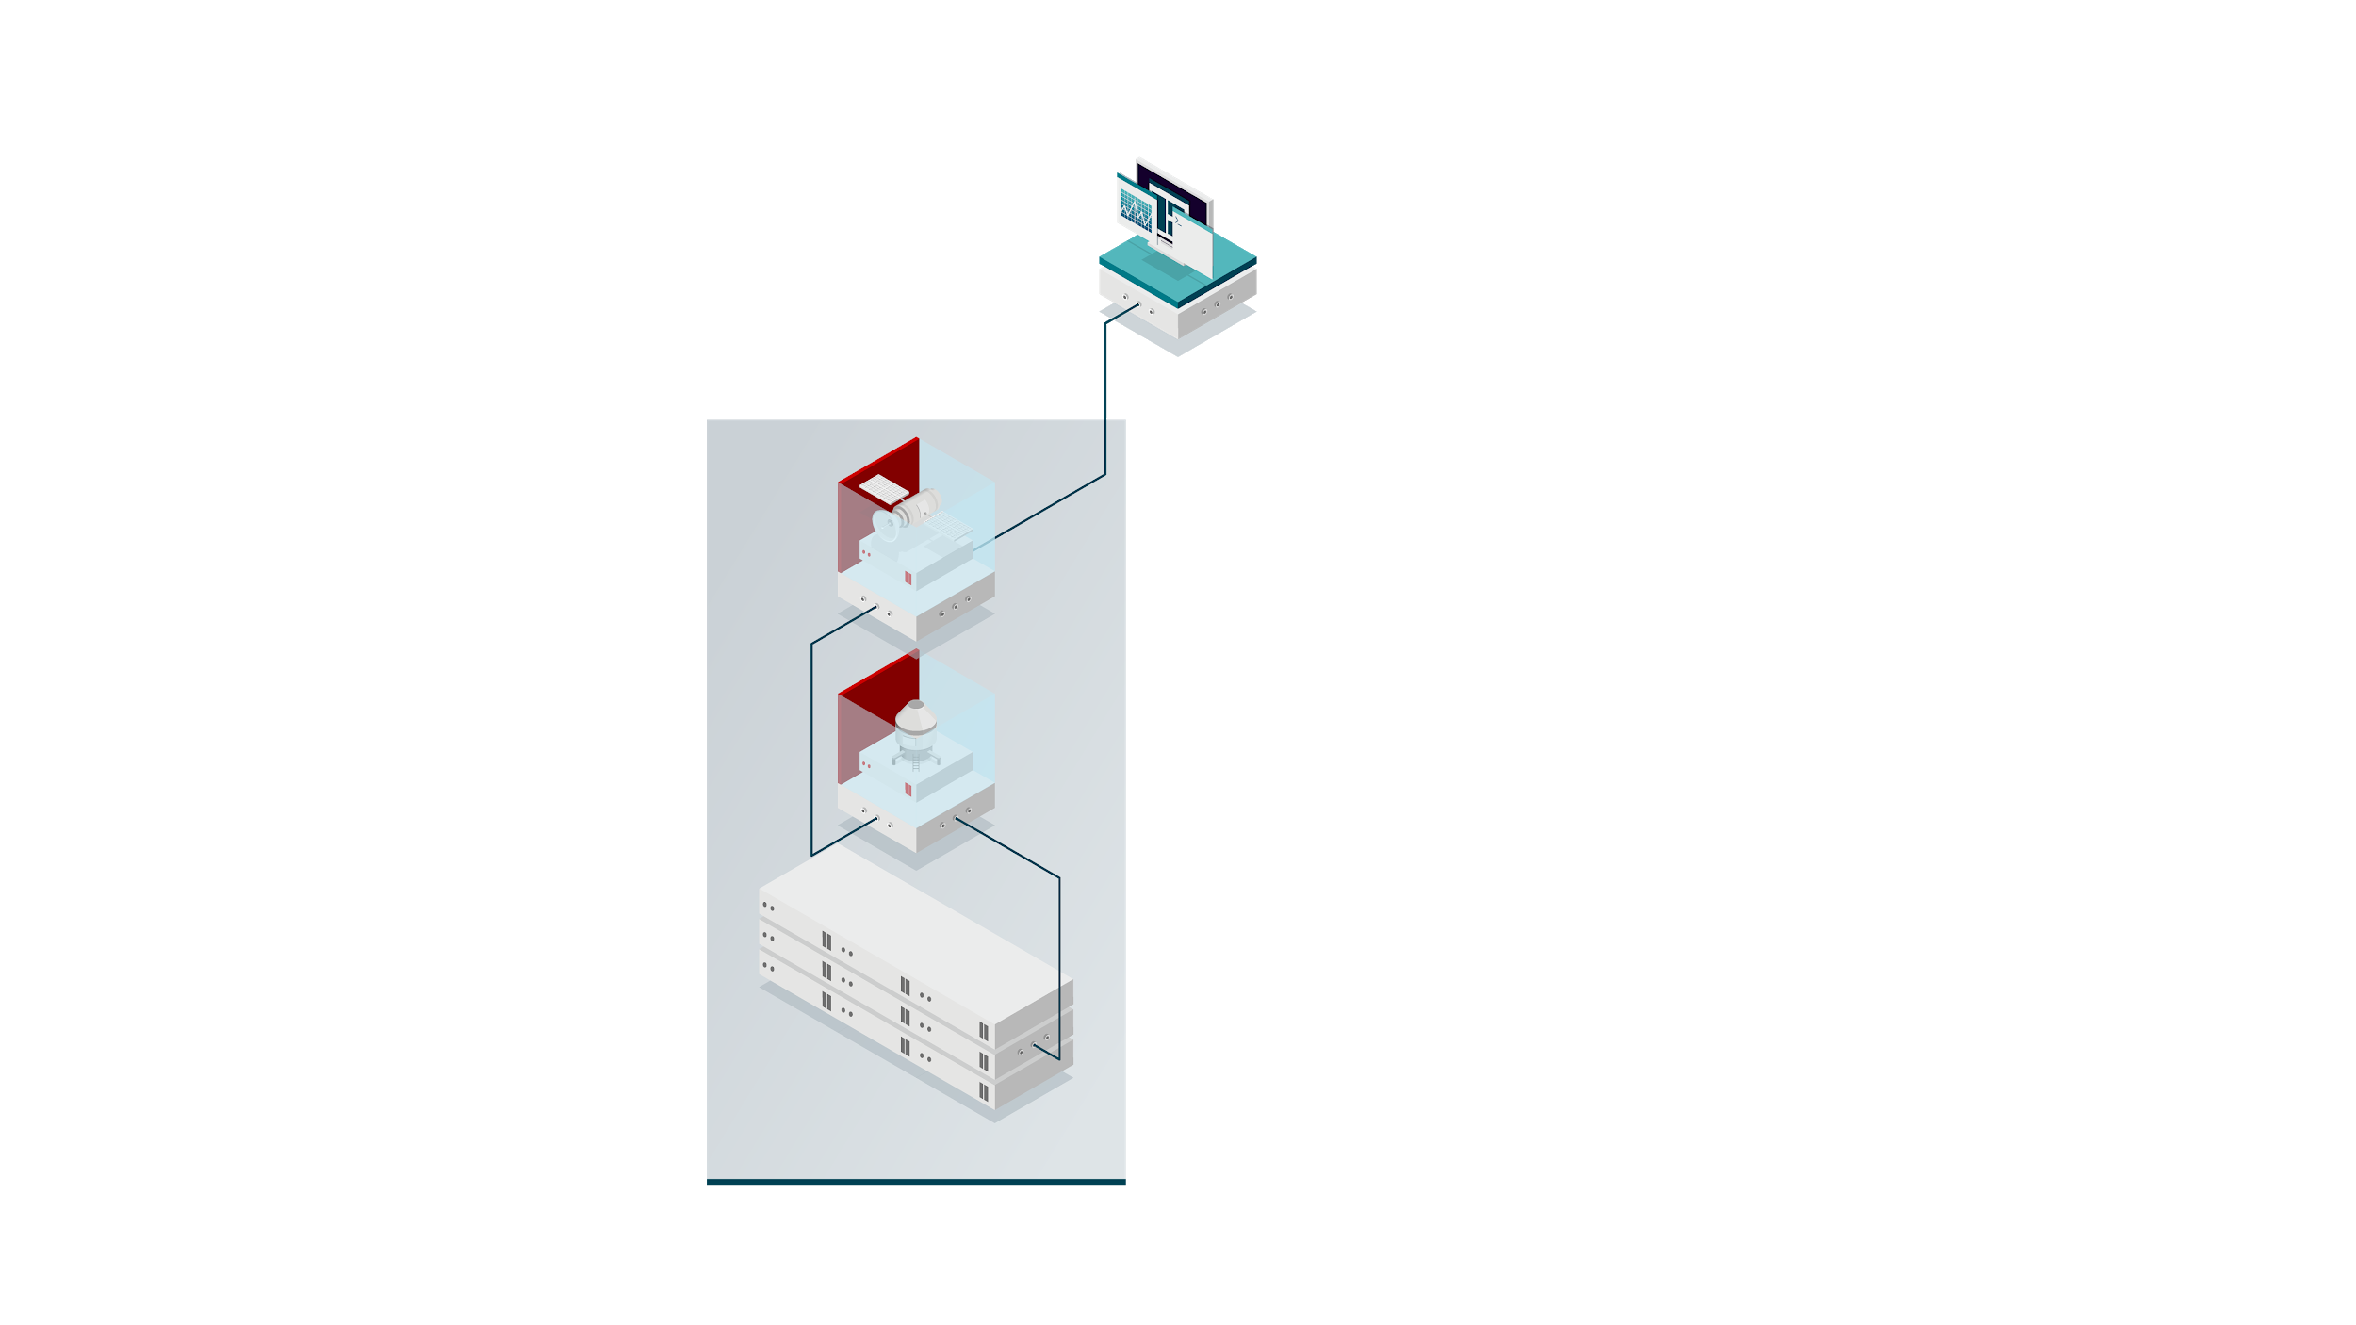
Red Hat® Satellite in 3 scenarios
Red Hat Satellite
CLOUD.REDHAT.COM
CONTENT
RED HAT SATELLITE
CAPSULE
ATLANTA DATACENTER
Notes:
-----
Start with the simplest scenario which is 1 Satellite and 1 Capsule connected to the internet
----
You have a group of hosts that you want to manage with Satellite.
These hosts are in the Atlanta datacenter
The hosts are connected to the Capsule. The Capsule is located closest to the hosts
The Capsule is connected to the Satellite
The Satellite is connected to the internet. From the internet we download content from Red Hat, Github, or any third party content provider
Through the Internet we also connect to cloud.redhat.com and Red Hat Insights

Slide 26
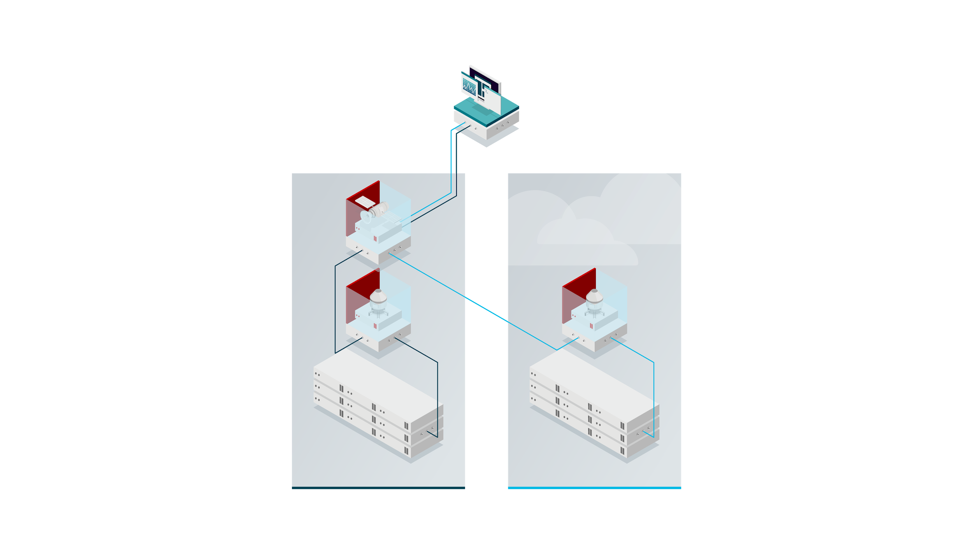
Red Hat Satellite in 3 scenarios
Red Hat Satellite
CLOUD.REDHAT.COM
CONTENT
ATLANTA DATACENTER
CLOUD-BASED INFRASTRUCTURE
Notes:
--------
Scenario 2 - second capsule in the cloud or on premise
-------
Capsules can also be extended out to the cloud or to a remote datacenter where they are closest to the hosts
Hosts in the cloud can also connect to any Satellite or Capsule Server

Slide 27
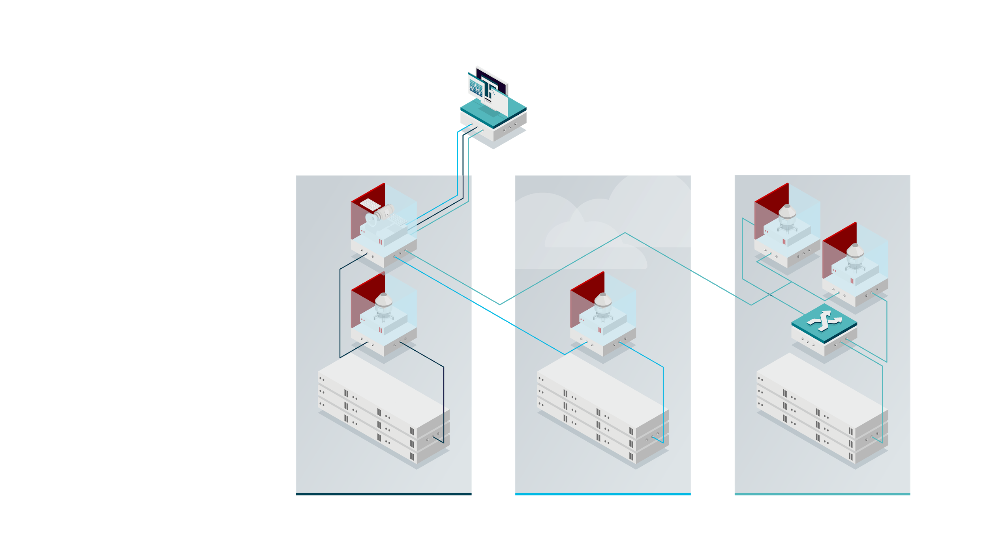
Red Hat Satellite in 3 scenarios
Red Hat Satellite
CLOUD.REDHAT.COM
CONTENT
LOAD
BALANCER
ATLANTA DATACENTER
CLOUD-BASED INFRASTRUCTURE
PHOENIX DATACENTER
Notes:
-----
Scenario 3 - Remote datacenter / load balancing
------
You can also load balance your capsules to provide a higher level of scalability. You need to provide a load balancer and behind that you can connect two or more capsule servers which will connect back to your Satellite.

Slide 28
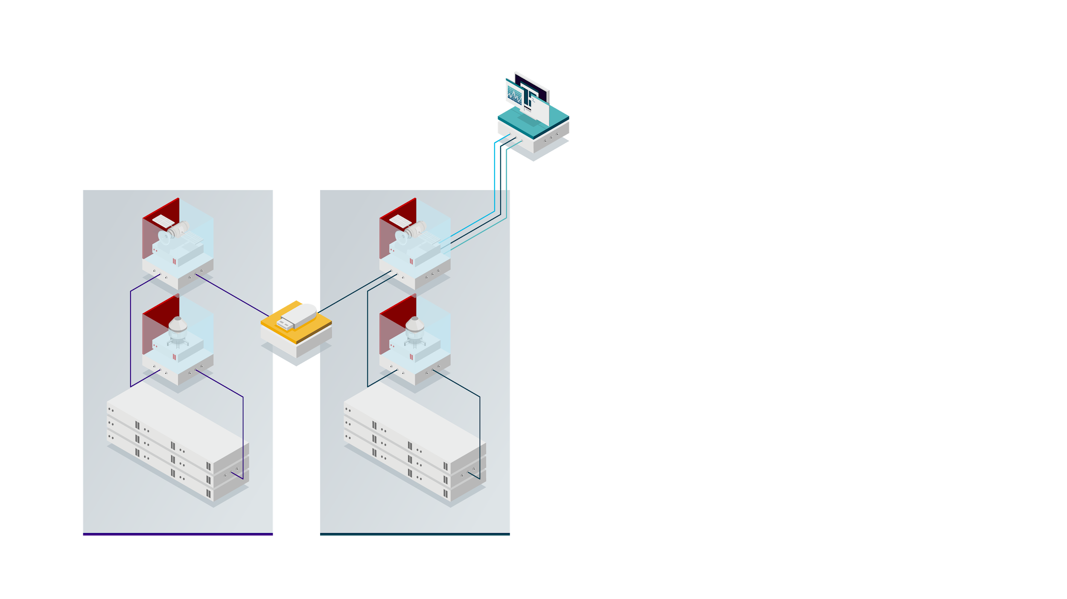
Red Hat Satellite in an air-gapped environment
Red Hat Satellite
CLOUD.REDHAT.COM
CONTENT
IMPORT
EXPORT
ISOLATED DATACENTER
ATLANTA DATACENTER
Notes:
You also have an isolated datacenter configured in much the same way, but no access to the Internet. This environment is disconnected, airgapped, or isolated - whichever term you like to use.
Your main Satellite in the Atlanta datacenter downloads the content and the Satellite admin organizes the content into content view as needed.
The Satellite admin then exports that content to a thumb drive, optical disc, or whichever media is preferred.
The data is then imported into the Satellite in the isolated datacenter.
It should be noted that this process imports the content as well as the metdata that make up the content view.
If you are exporting a content view version, then the content view needs to already exist on the host where you are importing the content view.
And any underlying repositories do need to already exist before you import a content view version.
This will greatly simplify the import and export of content view, helping to keep Satellites and Capsules that are in disconnected environments as close to the main Satellite as possible

Slide 29

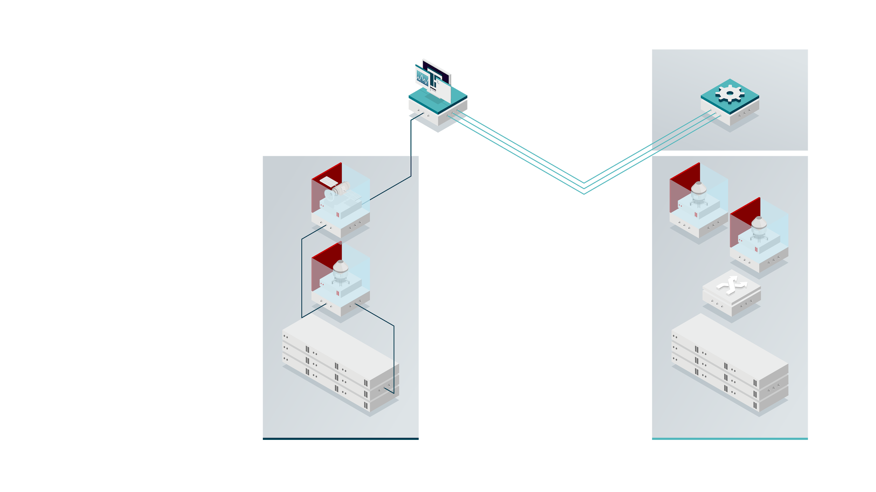
Red Hat Satellite with cloud services
Red Hat Satellite
CLOUD.REDHAT.COM
DEVELOPMENT GROUP
CONTENT
managed outside of Red Hat Satellite
ATLANTA DATACENTER
PHOENIX DATACENTER
Notes:
It is also possible that you have a group of hosts that exist outside of your Satellite environment.
In your Phoenix datacenter perhaps there is a development group that is spinning up and destroying systems that only live for hours, days, weeks, or months.
They don’t connect to the Satellite environment since their systems are so short lived.
However they do need to be aware of vulnerabilities or compliance issues that may be present.
These hosts connect directly to cloud management services for Red Hat Enterprise Linux, included in your Smart Management subscription.
Once the systems mature and are connected via Satellite, no changes are necessary - all hosts can be registered to Satellite and cloud management services for Red Hat Enterprise Linux.

Slide 30
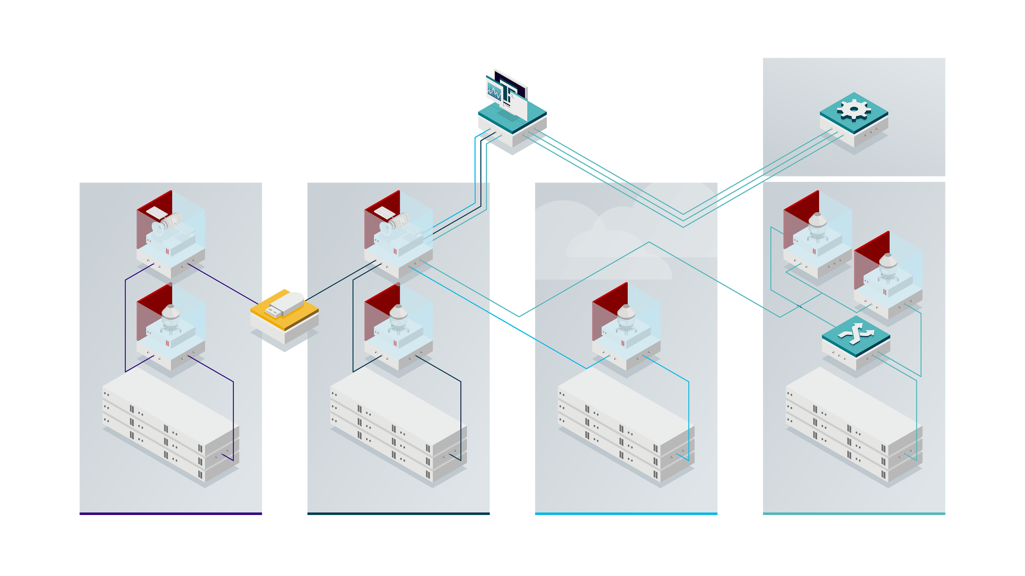
Red Hat Satellite overview
Red Hat Satellite
CLOUD.REDHAT.COM
DEVELOPMENT GROUP
CONTENT
managed outside of Red Hat Satellite
ISOLATED DATACENTER
ATLANTA DATACENTER
CLOUD-BASED INFRASTRUCTURE
PHOENIX DATACENTER
Notes:
When you put all of these scenarios together you can see that Satellite supports a complex enterprise environment.

Slide 31
Red Hat Satellite Upgrade
Red Hat Satellite

Slide 32
Red Hat Satellite Upgrade Information
Red Hat Satellite
Satellite 6.x to 6.6
Satellite 5.x to 6.6
Follow the Upgrading and Updating Red Hat Satellite Guide
Read the Transitioning Guide and FAQ to help plan the migration from Satellite 5 to Satellite 6
Reach out to your account manager to discuss consulting options
Note: Satellite 5.8 will be end of life as of May 31, 2020
Product docs page: https://access.redhat.com/documentation/en-us/red_hat_satellite/
Notes:
If you are a already running Satellite 6, upgrading to the latest version of Satellite is pretty simple and you can refer to the Satellite 6.3 upgrading and updating Red Hat Satellite Guide for full details.
If you are running Satellite 5 today then a transition is needed from Satellite 5 to Satellite 6. The same documentation page has several resources including a transitioning guide and a FAQ, but you may also want to reach out to your account manager to discuss consulting options.

Slide 33
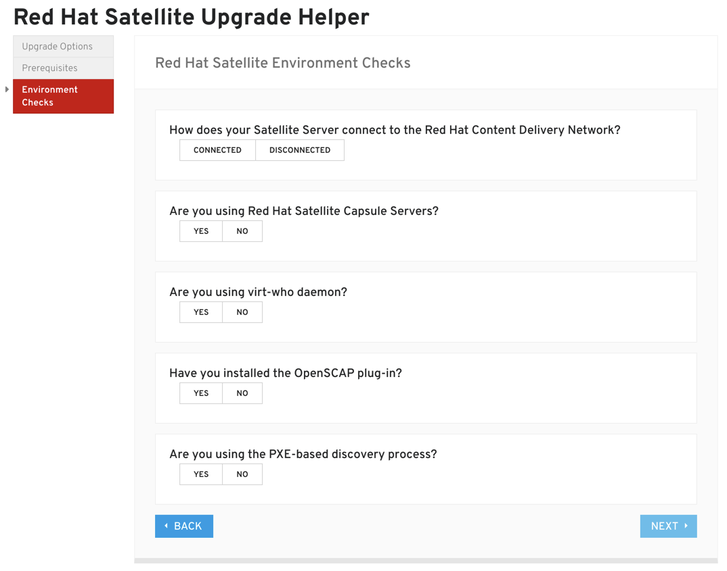
Red Hat Satellite Upgrade Helper
Red Hat Satellite
https://access.redhat.com/labsinfo/satelliteupgradehelper
Tool designed to help you upgrade from:
6.0 to 6.1
6.1 to 6.2
6.2 to 6.3
6.3 to 6.4
6.4 to 6.5
6.5 to 6.6
Upgrade helper presents upgrade steps and includes extra steps to help prevent any known issues.
Notes:
The upgrade helper can assist you in moving from older versions of Satellite 6 to the latest version and will also include extra steps to help prevent any known issues.
The Helper will ask you what portions of Satellite you are using like OpenSCAP or Puppet and include the appropriate steps for upgrading any of these additional components.

Slide 34
Satellite 6.6 New Features
Red Hat Satellite

Slide 35


Red Hat Satellite
Satellite 6.6 theme
Enhancements across automation, reporting, and support
Automation
Reporting
Support
Red Hat Satellite and Satellite Capsule Servers must be installed on a Red Hat Enterprise Linux® 7 Host

Slide 36



Red Hat Satellite
Red Hat Enterprise Linux 8
Security
Key focus areas
Support
Content management
Usability
Reporting
‹#›

Slide 37
Automation
Enhancements
Red Hat Satellite
Continuing Enhancements around Automation in Satellite

Slide 38

Red Hat Satellite
Automation enhancements
Continuing improvements with Red Hat Ansible® Automation Platform
Ansible 2.8 upgrade
Upgrading the built-in Ansible to the latest release
Smart class parameters
Ability to use Ansible Automation Platform variables as smart class parameters, making Ansible roles easier to use
OpenSCAP deployed by Ansible
Ability to deploy OpenSCAP using Ansible Automation Platform
‹#›

Slide 39
Reporting
Red Hat Satellite
Improvements to the Satellite reporting engine

Slide 40

Red Hat Satellite
Reporting engine enhancements
Reporting engine enhancements
• Schedule reports
• Email reports
• Performance improvements
Additional pre-canned report
• Applied errata
Notes:
6.5 introduced these reports:
Host Statuses
Subscriptions
Registered Hosts
Applicable Errata
6.6 added:
Applied errata report
Task report

Slide 41
Support
Red Hat Satellite
Supportability changes in Satellite 6.6

Slide 42

Red Hat Satellite
Security enhancements
Red Hat Insights rules for Satellite
Insights added more than 60 Satellite rules to help Satellite run at its best.
Content view filters dependency resolution
If a content view (CV) filter has a dependency on a package, it will include the dependency in the CV.
Image builder integration
Image Builder can pull content from Satellite and make install images that are pushed back to Satellite for the purpose of provisioning hosts
Notes:
Insights Rules for Satellite
Insights now includes >60 rules for Satellite. Many were based off of the performance guide and these help to identify performance issues or possible misconfigurations with your Satellite Server.
Requires that you are using Insights and you have the insights-client installed on your Satellite and/or Capsules
Content View Filters Dependency Resolution
When using CV filters Satellite will check for dependencies to help reduce failures that might be generated by bad filters
For example: filter removes glibc, but package requires glibc
This doesn't alert you, it just resolves the dependency.
This is a CV attribute, and is opt-in. Note that this DOES slow down publishing considerably (50-100%)
Image Builder
A user of Image Builder is able to pull content from Satellite in order to make install DVDs and images for deployment on bare metal. The Image Builder user is able to push the deployment images into Satellite. Satellite is then able to provision these images to bare metal either via (1) the anaconda image directive or (2) by using an image enhanced discovery ISO.

Slide 43
Red Hat Satellite
Security enhancements
Scale improvements and tuning parameters
T-shirt (small, medium, large) sized-based tuning parameters, including Heira files shipped with Satellite, and also includes task database cleanup
Improved upgrade workflows
Satellite-maintain is used for upgrades, and Satellite is version locked so yum doesn’t upgrade Satellite
Enhanced task dashboard and notifications
Improved task dashboard page and new notification drawer items for paused tasks or tasks that need attention
‹#›

Slide 44
Next Steps & Resources
Red Hat Satellite
Where to go to learn more

Slide 45
Red Hat Satellite
Next steps
Using Satellite 5.8 or earlier?
Using Satellite 6.2 or earlier?
Satellite 5.8 goes end-of-life (EOL) May 31, 2020.
Older versions are already EOL.
Satellite 6.2 and older versions are EOL.
Move to the latest version of Satellite 6.
Move to the latest version of Satellite 6.
Use the Upgrade Helper to plan your upgrade:
https://access.redhat.com/labs/satelliteupgradehelper/

Slide 46
Red Hat Satellite
Satellite resources
Red Hat Satellite blog
Red Hat Satellite product page
Red Hat Satellite customer portal
Red Hat Satellite documentation
Red Hat Consulting offering: Transition to Red Hat Satellite 6
Satellite training and videos
NEW COURSE RH053: Satellite Technical Overview (also available on Udemy)
RH403: Red Hat Satellite 6 Administration
Satellite 6.5 Reporting Engine Video

Slide 47
Thank you
Red Hat is the world’s leading provider of enterprise open source software solutions. Award-winning support, training, and consulting services make Red Hat a trusted adviser to the Fortune 500.

Slide 48
Alternate Slides
Satellite 6.5 New Features

Slide 49
Smart Management buying transition
Red Hat Satellite 6.5

Slide 50
Satellite and Smart Management buying transition
Before
March 1, 2018
Starting
March 1, 2018
Starting
May 1, 2019
Starting
August 1, 2019
Red Hat Satellite
Purchase one or more of the following:
• Red Hat Satellite Server
• Red Hat Satellite Capsule Server
• Smart Management add-on
Red Hat Insights:
Purchase the Insights add-on separately
Red Hat Smart Management: Red Hat Satellite + Red Hat Insights
Buy or renew a single Smart Management SKU and get a single Insights and the Satellite Infrastructure SKU (MCT3718) which grants 50 of any combination of Satellites and Satellite Capsule Servers.
Red Hat Smart Management = Red Hat Satellite + cloud management services for Red Hat Enterprise Linux
Insights included in all supported Red Hat Enterprise Linux subscriptions. Smart Management continues to provide Satellite infrastructure and now includes Software-as-a-service (SaaS)-based cloud management services for Red Hat Enterprise Linux.
All Smart Management customers get access to the MCT3718 SKU
Access to Satellite infrastructure and the cloud services, regardless of time of purchase.

Slide 51
Satellite and Red Hat Satellite Smart Management add-on buying transition
Red Hat Satellite 6.6
Before
March 1, 2018
Starting
March 1, 2018
Starting
May 1, 2019
Starting
August 1, 2019
Red Hat Satellite
Purchase one or more of the following:
• Red Hat Satellite server
• Red Hat Satellite Capsule server
• Satellite Smart Management add-on
Red Hat Insights:
Purchase the Insights add-on separately
Red Hat Satellite Smart Management add-on: Red Hat Satellite + Red Hat Insights
Buy or renew a single Smart Management SKU and get a single Insights and the Satellite Infrastructure SKU (MCT3718) which grants 50 of any combination of Satellites and Capsules.
Red Hat Smart Management add-on = Red Hat Satellite + cloud management services for Red Hat Enterprise Linux
Insights included in all supported Red Hat Enterprise Linux subscriptions. Smart Management add-on continues to provide Satellite infrastructure and now includes SaaS-based cloud management services for Red Hat Enterprise Linux.
All Smart Management add-on customers get access to the MCT3718 SKU
Access to Satellite infrastructure and the cloud services, irrespective of when they purchased.
Notes:
In all supported RHEL subscriptions

Slide 52
Support for Cloud providers in Satellite
Red Hat Satellite 6.5

Slide 53




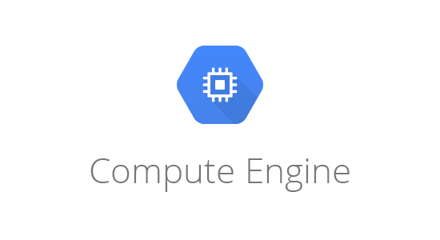


As of Red Hat Satellite 6.5:
Running Satellite in the cloud typically means one of these three things:
Cloud provider | Can I run Satellite in this cloud provider?* | Can I manage hosts in this cloud provider? | Can I provision hosts in this cloud provider?
AWS includes AWS Cloud for Government
Azure includes Microsoft Azure for Government
*Cloud providers not listed require a support exception
Where Satellite is mentioned, Capsules are also supported.
‹#›

Slide 54
Lifecycle Environments
Red Hat Satellite 6.5

Slide 55


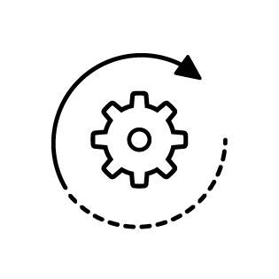


Life-cycle environments
RED HAT SATELLITE 6.5
In this sample environment, we have 2 promotion paths:
1 for SAP systems, and 1 for the rest.
Most servers:
SAP environments:
DEVELOPMENT
QUALITY
ASSURANCE
PRODUCTION
DEVELOPMENT
QUALITY
ASSURANCE
USER ACCEPTANCE TESTING
STAGING
PRODUCTION
Notes:
Lifecycle Environments should match software lifecycle environments.
Example: Most of your servers follow this lifecycle path to production:
Dev → QA → Production
SAP environments follow:
Dev → QA → UAT → Staging → Production
In this case you would have 2 promotion paths, one for most servers and one for SAP.
Lifecycle Environments can be selectively synchronized to Capsules

Slide 56

Life-cycle environments
RED HAT SATELLITE 6.5
CONTENT LIBRARY
DEVELOPMENT
QUALITY ASSURANCE
PRODUCTION
All content
Uses the newest packages
———
Includes development packages
Removes development packages
———
Includes some automation tools
———
Promoted from development
Uses known stable libraries
———
Does not include development packages or automation tools ———
Promoted from quality assurance
Notes:
Life-cycle environments should match software life-cycle environments.
Example:
Your serves follow this life-cycle path to production:
Dev, QA, Prod
SAP environments go:
Dev, QA, UAT, Staging, Production
Can have multiple promotion paths
Life-cycle environments can be selectively synchronized to capsules

Slide 57
Content Views
Red Hat Satellite 6.5

Slide 58



Content views
RED HAT SATELLITE 6.5
A content view (CV) is a managed selection of content that contains 1 or more repositories with optional filtering.
Custom subset
Define specific versions of software
Activation keys
Enable and disable content views as needed
Composite content views
Made up of multiple content views
Notes:
Content Views (CVs) are a custom subset of the total repositories in your environment - CV is a snapshot of the packages you want your environment to include -
You can use a CV to define specific versions of software
The Production environment might use older, stable package versions
The Test or Development environments might use newer package versions
Activation Keys allow you to enable/disable CVs as needed
Composite Content Views (CCVs) are made up of multiple CVs
These can be auto-published when any component CV is published

Slide 59


Content views
Web app CV 1.0
Web app CV 2.0
3 repositories
900 packages
3 repositories
980 packages
Python 3.5
Java 1.7
Web.apk 2.1
Python 3.6
Java 1.8
Web.apk 2.2
Base OS CV 1.0
Base OS CV 2.0
4 repositories
24,000 packages
4 repositories
25,000 packages
Content library
Kernel 3.10.0-862.2.3.e17
Red Hat Enterprise Linux 7.5
Extra Packages for Enterprise Linux (EPEL) 7
Kernel 3.10.0-862.11.6.el17
Red Hat Enterprise Linux 7.5
Extra Packages for Enterprise Linux (EPEL) 7
‹#›
Notes:
Satellite serves as the on-premise repository of Red Hat Products, packages, Puppet Modules, and custom repos.
Administrators use Satellite’s advanced content management system to construct standard builds in the form of Content Views
Content Views are added to host groups.
This combines content with provisioning templates and puppet classes
Activation keys can be added
Allows for the optional specification of subnet and domain
Permits host group stacking for modularity
Composite content views can be added to host groups
Content views are published and promoted into life cycle environments
Host groups coalesce provisioning artifacts
Capsules supply content, drive PXE build & config

Slide 60

Composite content view
RED HAT SATELLITE 6.5
Composite content views (CCV) are made up of multiple content views, rather than individual repositories.
Auto-publish
These can be auto-published when any component content view is published
Notes:
Composite Content Views (CCVs) are made up of multiple content views
These can be auto-published when any component CV is published

Slide 61
Composite content views
CCV 1.0 for web
CCV 2.0 for web
7 repositories
7 repositories
Base OS CV 1.0
Base OS CV 2.0
Web app CV 1.0
Web app CV 1.0
Content library
‹#›
Notes:
Satellite serves as the on-premise repository of Red Hat Products, packages, Puppet Modules, and custom repos.
Administrators use Satellite’s advanced content management system to construct standard builds in the form of Content Views
Content Views are added to host groups.
This combines content with provisioning templates and puppet classes
Activation keys can be added
Allows for the optional specification of subnet and domain
Permits host group stacking for modularity
Composite content views can be added to host groups
Content views are published and promoted into life cycle environments
Host groups coalesce provisioning artifacts
Capsules supply content, drive PXE build & config

Slide 62
Software Deployment
Red Hat Satellite 6.5
Using content views, composite content views,
and life-cycle environments

Slide 63





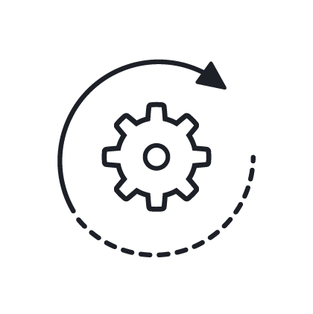
Software deployment
RED HAT SATELLITE 6.5
UPDATE
CCV 2.0 BaseOS CV 2.0 + WebApp CV 1.0
CCV 3.0 BaseOS CV 2.0 + WebApp CV 2.0
PROMOTE
Development CCV 3.0
Quality assurance CCV 2.0
Production CCV 2.0
Notes:
Here is an example of this in action.
In CCV2.0 you have a BaseOS CV2.0 and a WebApp CV1.0.
If you update the WebApp CV to include a newer version of Python, this can automatically update the CCV to version 3.0.
Now when you promote CCV 3.0 through the lifecycle environment the development environment gets updated to the latest.
The QA and Prod environments stay at CCV2.0 until you promote to that environment.

Slide 64
Supply Chain Security
It all starts with the code - how do you make sure it hasn’t been tampered with?

Slide 65










Supply chain security
RED HAT SATELLITE 6.6
Out of millions of projects, Red Hat identifies those that are critical for modern enterprises.
Upstream community leadership

Slide 66

Supply chain security
RED HAT SATELLITE 6.6
A subset of projects is selected for the community distribution called Fedora.
Upstream community leadership
Red Hat bugzilla
package review

Slide 67

Supply chain security
RED HAT SATELLITE 6.6
Fedora creates an environment where projects can be integrated and stabilized.
Upstream community leadership
Red Hat bugzilla
package review
Packages tracked for release in Fedora®

Slide 68

Supply chain security
RED HAT SATELLITE 6.6
The package is thoroughly analyzed and the used crypto libraries are critically reviewed.
Upstream community leadership
Red Hat bugzilla
package review
Packages tracked for release in Fedora®
Some packages are selected for Red Hat® Enterprise Linux®

Slide 69

Supply chain security
RED HAT SATELLITE 6.6
Code is scanned and issues are identified and addressed to prevent security flaws. Issues are reported and addressed via upstream open source projects.
Upstream community leadership
Red Hat bugzilla
package review
Packages tracked for release in Fedora®
Some packages are selected for Red Hat® Enterprise Linux®
Static code analysis

Slide 70
Supply chain security
RED HAT SATELLITE 6.6
ASLR, PIE, and RELRO flags set for stack protection.*
Upstream community leadership
Red Hat bugzilla
package review
Packages tracked for release in Fedora®
Some packages are selected for Red Hat® Enterprise Linux®
Static code analysis
Compiler flags set for hardening and security
*Address Space Layout Randomization (ASLR), Position-Independent Execution (PIE), and RELocation Read-Only (RELRO) flags

Slide 71

Supply chain security
RED HAT SATELLITE 6.6
Multiple tiers of testing are conducted, including low-level functional, system-level, and cross-product testing
Upstream community leadership
Red Hat bugzilla
package review
Packages tracked for release in Fedora®
Some packages are selected for Red Hat® Enterprise Linux®
Static code analysis
Quality engineering (QE) testing conducted extensively every release
Compiler flags set for hardening and security

Slide 72

Supply chain security
RED HAT SATELLITE 6.6
Repeatable build pipeline with digitally signed output provides the origin and consistency of packages
Upstream community leadership
Red Hat bugzilla
package review
Packages tracked for release in Fedora®
Some packages are selected for Red Hat® Enterprise Linux®
Static code analysis
All packages are digitally signed
Quality engineering (QE) testing conducted extensively every release
Compiler flags set for hardening and security

Slide 73

Supply chain security
RED HAT SATELLITE 6.6
Delivery via pipelines that provide guarantees of the consistency and source of the content
Upstream community leadership
Red Hat bugzilla
package review
Packages tracked for release in Fedora®
Some packages are selected for Red Hat® Enterprise Linux®
Static code analysis
Trusted distribution
All packages are digitally signed
Quality engineering (QE) testing conducted extensively every release
Compiler flags set for hardening and security

Slide 74

Supply chain security
RED HAT SATELLITE 6.6
Upstream community leadership
Red Hat bugzilla
package review
Packages tracked for release in Fedora®
Some packages are selected for Red Hat® Enterprise Linux®
Static code analysis
Continuous security updates
Secure distribution
All packages are digitally signed
Quality engineering (QE) testing conducted extensively every release
Compiler flags set for hardening and security
Notes:
Satellite serves as the on-premise repository of Red Hat Products, packages, Puppet Modules, and custom repos.
Administrators use Satellite’s advanced content management system to construct standard builds in the form of Content Views
Content Views are added to host groups.
This combines content with provisioning templates and puppet classes
Activation keys can be added
Allows for the optional specification of subnet and domain
Permits host group stacking for modularity
Composite content views can be added to host groups
Content views are published and promoted into life cycle environments
Host groups coalesce provisioning artifacts
Capsules supply content, drive PXE build & config

Slide 75
Red Hat Satellite - Trusted Supply Chain
Ensuring that content makes it from Red Hat to your systems without being tampered with.

Slide 76





Trusted software supply chain
RED HAT SATELLITE 6.6
RPM package
Red Hat CDN
Entitlement certificate
Satellite server
Hosts
Every RPM package is signed with a gnu privacy guard (GPG)key.
Notes:
Every RPM released by Red Hat is digitally signed with the appropriate GPG key (for example, beta or GA).

Slide 77

Trusted software supply chain
RED HAT SATELLITE 6.6
RPM package
Red Hat CDN
Entitlement certificate
Satellite server
Hosts
Every RPM package is signed with a GPG key.
Each package or content type is pushed to the Red Hat content delivery network (CDN).
Notes:
Each package or content type is pushed out to a CDN that is run by Akamai

Slide 78

Trusted software supply chain
RED HAT SATELLITE 6.6
RPM package
Red Hat CDN
Entitlement certificate
Satellite server
Hosts
Every RPM package is signed with a GPG key.
Each package or content type is pushed to the Red Hat CDN.
Access to the package requires a Red Hat-issued entitlement certificate.
Notes:
Content is only accessible from the CDN via entitlement certificates that are issued by Red Hat

Slide 79
Trusted software supply chain
RED HAT SATELLITE 6.6
RPM package
Red Hat CDN
Entitlement certificate
Satellite Server
Hosts
Every RPM package is signed with a GPG key.
Each package or content type is pushed to the Red Hat CDN.
Access to the package requires a Red Hat-issued entitlement certificate.
Satellite verifies the packages have not been modified by comparing the checksums.
Notes:
Tools, like Satellite, which need to interact with that content (such as syncing it) verify that the packages have not been modified in transit. This is done by comparing the checksum of the package against the checksum listed in the repositories metadata.

Slide 80
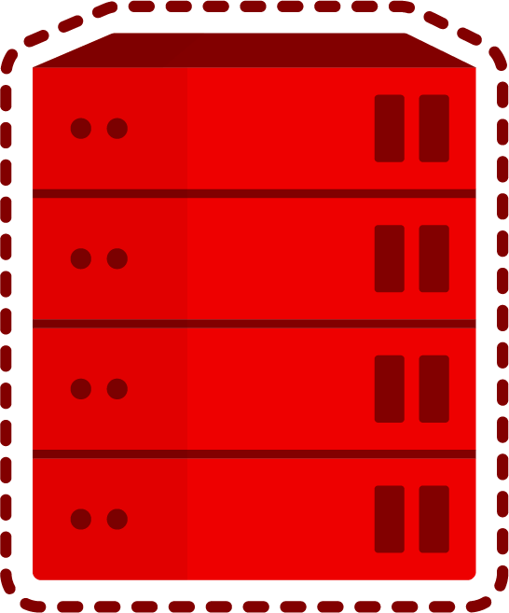
Trusted software supply chain
RED HAT SATELLITE 6.6
RPM package
Red Hat CDN
Entitlement certificate
Satellite Server
Hosts
Every RPM package is signed with a GPG key.
Each package or content type is pushed to the Red Hat CDN.
Access to the package requires a Red Hat-issued entitlement certificate.
Satellite verifies the packages have not been modified by comparing the checksums.
Client tools also verify checksums and verify GPG signature matches.
Notes:
The client tools (like yum/rpm) also compare the checksums AND verify that the GPG signature matches.
Alternatively, if you are supporting disconnected environments Satellite has import/export capabilities, and the whole 'verify the content when you touch it' model will extend there as well.
---Additional CDN information---
The CDN itself is not protected against tampering. A miscreant could compromise a CDN mirror, replace RPMs and rewrite the metadata for the repo. Tools like Satellite would be none the wiser.
However, the client will eventually reject the RPM unless it is signed with a Red Hat GPG key
Since we know you don't want malicious RPMs just hanging out in Satellite. There is an effort to address this
(https://projects.engineering.redhat.com/browse/DELIVERY-3689) by digitally signed repository metadata.

Slide 81
Satellite & Ansible
More info
Satellite 6.5 New Features
How Satellite and Ansible work together

Slide 82

RED HAT SATELLITE 6.6
Satellite and Ansible Tower integration
Documented best practices to help optimize use of both products
By integrating Red Hat Satellite with
Red Hat Ansible® Tower, administrators can
now perform the following functions:
Dynamic inventory
Allows Ansible Tower to use Satellite as a dynamic inventory source
Provisioning callbacks
Allows systems provisioned via Satellite to “callback”
to Ansible Tower so that playbook runs can happen
post-provisioning
Notes:
In Satellite 6.3 we introduced a couple integrations with Ansible Tower.
These are documented best practices focusing on two use cases:
Dynamic Inventory which allows Tower to use Satellite as a dynamic inventory source.
And Provisioning Callbacks which Allows systems provisioned via Satellite to ‘callback’ to Tower so Ansible Tower can run playbooks after provisioning completes.
These required both Satellite and Ansible Tower.
While neither product requires the other, using both can offer some great benefits.

Slide 83
Red Hat Satellite and Red Hat Ansible® Automation Platform integration
Documented best practices to help optimize use of both products
Red Hat Satellite 6.6
By integrating, administrators can now perform the following functions:
Dynamic inventory
Allows Ansible Automation Platform to use Satellite as a dynamic inventory source.
Provisioning callbacks
Allows systems provisioned via Satellite to “callback”
to Ansible Tower so that the playbook runs can happen
post-provisioning.
Notes:
In Satellite 6.3 we introduced a couple integrations with Ansible Tower.
These are documented best practices focusing on two use cases:
Dynamic Inventory which allows Tower to use Satellite as a dynamic inventory source.
And Provisioning Callbacks which Allows systems provisioned via Satellite to ‘callback’ to Tower so Ansible Tower can run playbooks after provisioning completes.
These required both Satellite and Ansible Tower.
While neither product requires the other, using both can offer some great benefits.

Slide 84
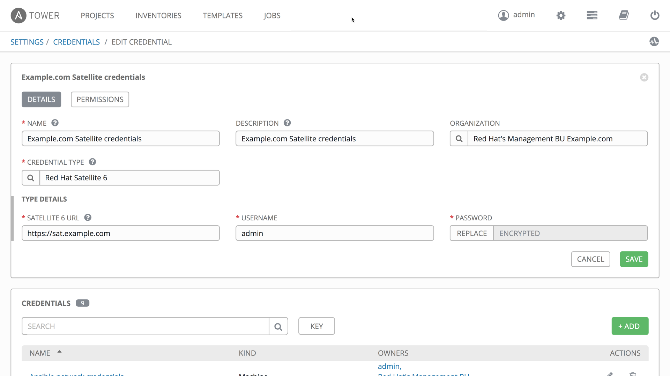
DYNAMIC INVENTORY
Notes:
Much like we saw with Insights, Satellite can be used as an inventory source inside of tower.
The advantages here are as you provision systems with or add systems to Satellite, you can dynamically access those hosts from within Tower.

Slide 85
Red Hat Satellite 6.6
Dynamic inventory
‹#›
Notes:
Much like we saw with Insights, Satellite can be used as an inventory source inside of tower.
The advantages here are as you provision systems with or add systems to Satellite, you can dynamically access those hosts from within Tower.

Slide 86
PROVISIONING CALLBACKS
A definition straight from the Tower documentation
Provisioning callbacks are a feature of Tower that allow a host to initiate a playbook run against itself, rather than waiting for a user to launch a job to manage the host from the tower console.

Slide 87
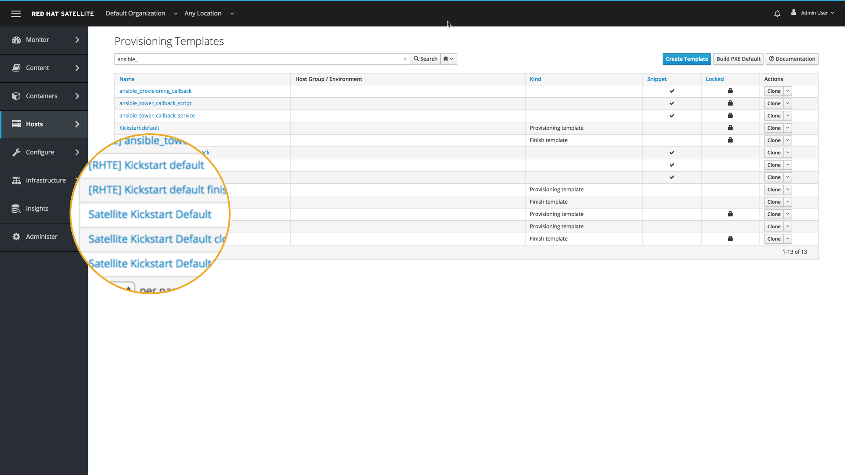
POST-PROVISIONING CALLBACK
Notes:
One of the key use cases for Satellite is provisioning.
You can provision a host in several different ways with Satellite, both VM and bare metal.
As part of the default provisioning templates we have built in snippets to call back to Tower to perform post-provisioning tasks.
Let’s start by taking a look at the Satellite kickstart default template.

Slide 88
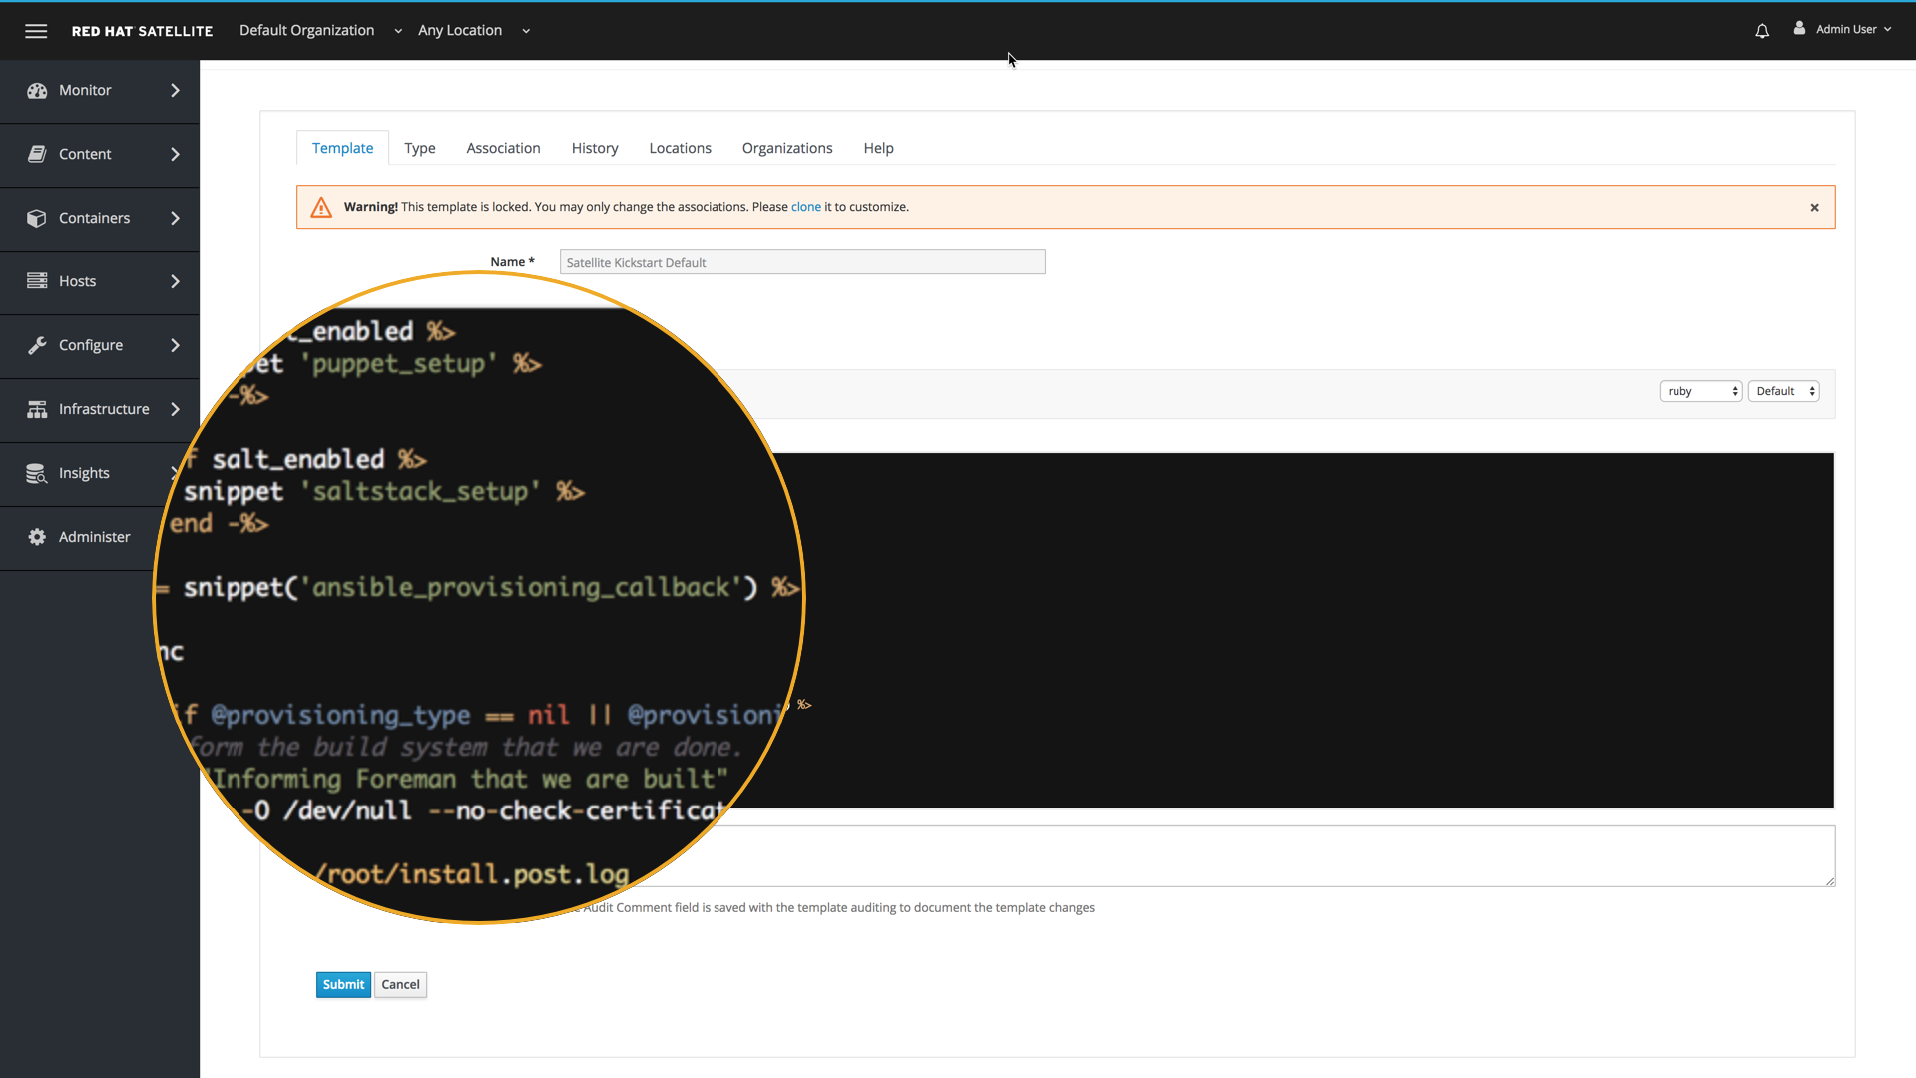
POST-PROVISIONING CALLBACK
Notes:
As part of this template there is a reference to the ansible provisioning callback template.

Slide 89
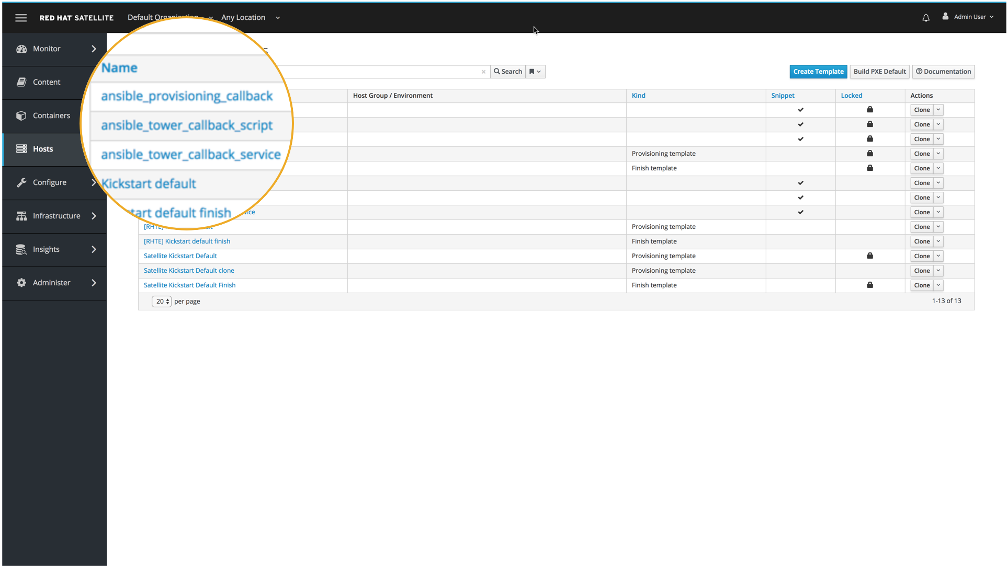
POST-PROVISIONING CALLBACK
Notes:
These snippets are accessible from the provisioning templates inside Satellite as well, so let’s take a look at the provisioning callback

Slide 90
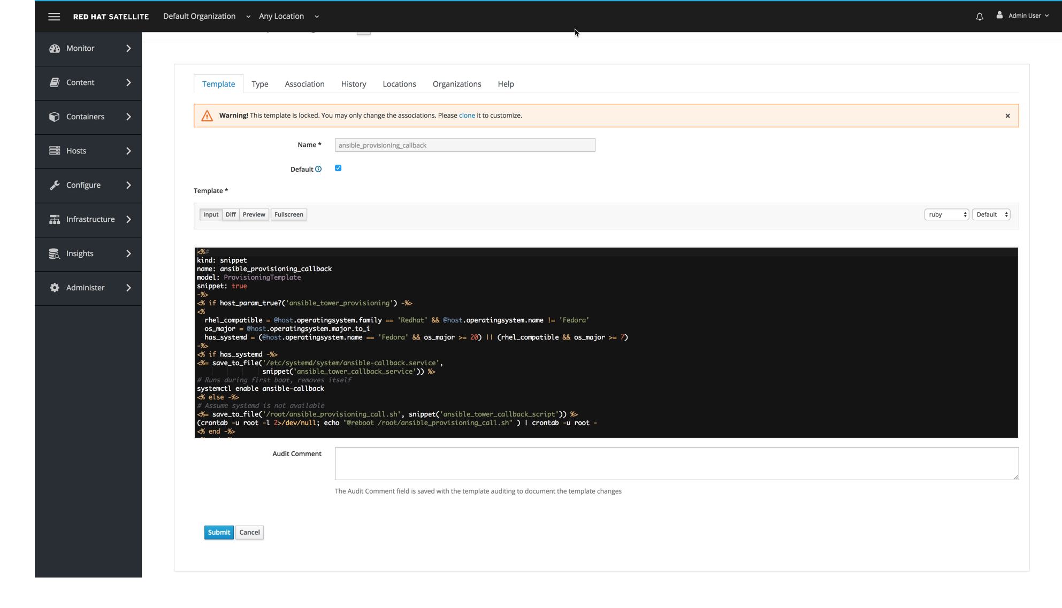
POST-PROVISIONING CALLBACK
Notes:
You likely can’t read this, so I’ll make it a bit bigger

Slide 91
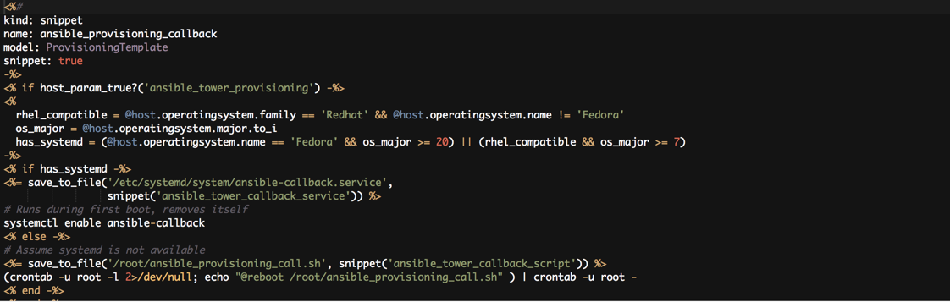
POST-PROVISIONING CALLBACK
Notes:
Notice that we have reference to the callback service and the callback script for Tower here as well.
This can be used to perform any post provisioning task with Ansible Tower after you provision the base OS with Satellite.
So Satellite can install the OS, all necessary patches, and any other software Satellite has as content, then we pass off more complex tasks to Tower.

Slide 92
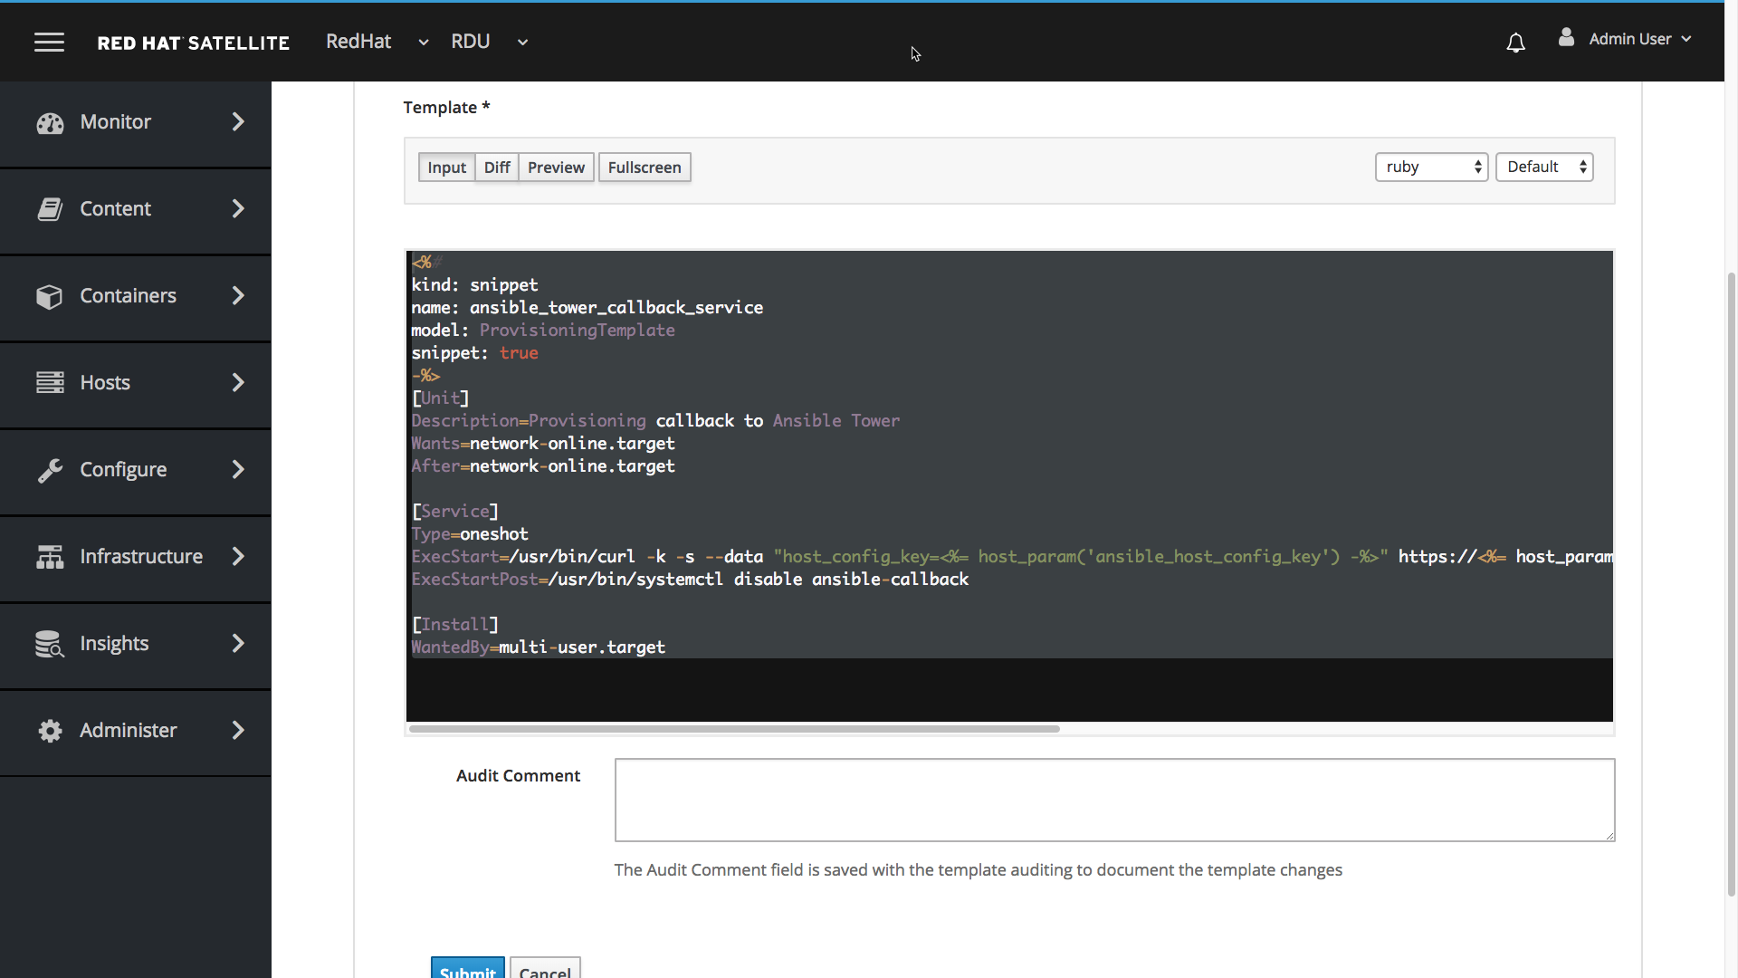
POST-PROVISIONING CALLBACK

Slide 93
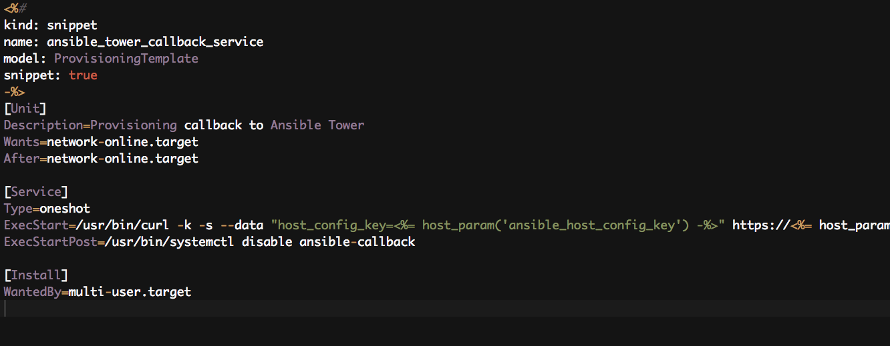
POST-PROVISIONING CALLBACK
Notes:
This gets installed on the box and identifies what job to run on the Tower after provisioning
Notice the URL strong that points to the /callback directory on the Tower.

Slide 94
ExecStart=/usr/bin/curl -k -s --data "host_config_key=<%= host_param('ansible_host_config_key') -%>" https://<%= host_param('ansible_tower_fqdn') -%>/api/v2/job_templates/<%= host_param('ansible_job_template_id') -%>/callback/
POST-PROVISIONING CALLBACK
Notes:
This gets installed on the box and identifies what job to run on the Tower after provisioning
Notice the URL string that points to the /callback path on the Tower.
Can even call the Satellite API to run the next step in a provisioning chain.

Slide 95

Satellite /Ansible Integration
Basic Ansible capabilities are now part of Satellite
Satellite has integration with Ansible for the purposes of remote execution and desired state management
Remote Execution
Run Ansible Playbooks inside of Satellite
Deploy Insights using Ansible
Install Insights on all your hosts
RHEL System Roles
Deploy RHEL System Roles to hosts managed by Satellite
Notes:
In addition to the Tower integration, coming soon Satellite 6.4 is going to have embedded Ansible capability.
This capability is specifically for the purposes of performing desired state management and remote execution of systems managed by Satellite.
Examples of ways this can help you is we can now execute an Ansible Playbook on a host managed by Satellite. So if you are using Insights, and Insights has a playbook to remediate a vulnerability, Satellite can natively run the playbook without downloading it and copying it to Ansible Engine or Ansible Tower.
You can also now deploy Insights using Ansible from within Satellite.
This is something you could do previously with Puppet, but now you can do it with Ansible as well.
We also support RHEL System Roles. In case you are not aware of RHEL system roles, they are a collection of Ansible roles and modules that provide a stable and consistent configuration interface to remotely manage RHEL 6.9 and later versions of Red Hat Enterprise Linux.
These roles can be imported into Satellite and used.

Slide 96
Find it, Fix it, Before it Breaks
Satellite 6.5 New Features
Demo of Satellite, Insights, and Ansible

Slide 97
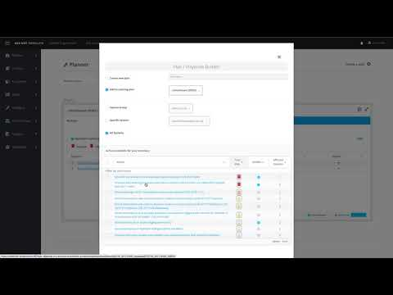

Slide 98
How does this work?
Satellite 6.5 New Features
Demo of Satellite, Insights, and Ansible

Slide 99




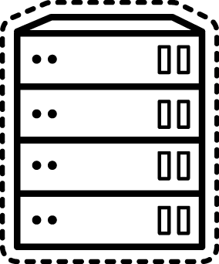




Basic Communication Flow
USER
SATELLITE SERVER
CAPSULE SERVER(S)
HOSTS
Notes:
Here is the general communication flow:
User interacts with Satellite
Satellite talks to Insights (for reading risks that Insights has detected, or for downloading Ansible playbooks that Insights has to fix detected risks)
Satellite talks to Capsules
Capsules talks to Hosts
(This is a recommended deployment model for Satellite. Connect your host to a capsule and the capsules to the Satellite. Especially with 6.4 when we can load balance capsules in a supported fashion.)

Slide 100
Data Sent to Insights for examination
Insights does this daily, automatically
USER
SATELLITE SERVER
CAPSULE SERVER(S)
HOSTS
Notes:
Data is sent from the host to Insights for evaluation.
Insights does this daily.
*motion graphic from here: https://www.picgifs.com/graphics/arrows/graphics-arrows-769209

Slide 101



Risk Found!
Satellite reads the data from Insights, dashboard widgets show the new risk
Oh no...
USER
SATELLITE SERVER
CAPSULE SERVER(S)
HOSTS
*Satellite does not store any information from Insights in the database. It is all real time.
Notes:
Satellite reads the data from Insights, so when a user looks at the dashboard widgets they’ll see the new risk
(The data from Insights is not stored in the Satellite database - it is always pulled in real time)

Slide 102

Create a Remediation Plan
A user creates the remediation plan through Satellite
I can fix it!
USER
SATELLITE SERVER
CAPSULE SERVER(S)
HOSTS
Notes:
User creates a remediation plan within the Satellite UI.
For this example we’ll pretend we are fixing a risk that has an associated playbook for remediation.

Slide 103
Plan Executes
Playbook is downloaded from Insights.
Satellite parses playbook per host
Satellite schedules the remote execution job(s)
I can fix it!
USER
SATELLITE SERVER
CAPSULE SERVER(S)
HOSTS
Notes:
Let’s say you have 10 hosts that have this risk (or 1000 - concept is the same).
The playbook that is downloaded from Insights is one playbook that has the fix for all hosts.
Satellite takes the downloaded playbook and parses it out on a per host basis. So we end up with 10 playbooks, one for each host.
Satellite schedules remote execution jobs - one for each host.
-----
On Satellite there's a master task
for each remediation and subtask for each host on which we run it. Each such
subtask has a 1:1 link to capsule tasks that represents ansible-playbook run
for a given host.
Each host remediation can go through different Capsule. The logic for
determining it is described here [1].
[1] https://www.theforeman.org/plugins/foreman_remote_execution/1.3/
index.html#4.1Determiningthesmartproxyforhost

Slide 104
Plan Executes
Playbook is downloaded from Insights.
Satellite parses playbook per host
Satellite schedules the remote execution job(s)
Capsule runs playbooks using Ansible against each host.
I can fix it!
USER
SATELLITE SERVER
CAPSULE SERVER(S)
HOSTS
Notes:
4) The Capsules execute the playbooks using Ansible. Each remediation could go through a different capsule
-----
On Satellite there's a master task
for each remediation and subtask for each host on which we run it. Each such
subtask has a 1:1 link to capsule tasks that represents ansible-playbook run
for a given host.
Each host remediation can go through different Capsule. The logic for
determining it is described here [1].
[1] https://www.theforeman.org/plugins/foreman_remote_execution/1.3/
index.html#4.1Determiningthesmartproxyforhost

Slide 105
Data Sent to Insights for examination
Rescan is done after remediation completes
USER
SATELLITE SERVER
CAPSULE SERVER(S)
HOSTS
Notes:
As soon as a risk is remediated, a rescan is initiated.

Slide 106

Data Sent to Insights for examination
The dashboard will pull updated info from Insights, showing the risk was resolved.
USER
SATELLITE SERVER
CAPSULE SERVER(S)
HOSTS
Notes:
In this case the risk was properly remediated, and the Satellite Dashboard is updated to reflect this.
The admin can go back to his day.

Slide 107
ANSIBLE & SATELLITE
While Satellite has Ansible capabilities built in, Ansible Tower is still critical for enterprise automation
Satellite’s use of Ansible is for RHEL-specific purposes
Ansible Playbooks can be executed against managed RHEL hosts
Ansible Roles provide desired state
Automation will be limited to RHEL use cases only
Satellite connected to Ansible Tower
For enterprise-wide, open-ended IT orchestration and automation
Management of non-RHEL systems alongside RHEL systems
Automate Satellite actions alongside other enterprise requirements
Notes:
We started by talking about the 6.3 integration with Ansible Tower then spoke about the 6.4 enhanced automation.
It is very important to point out the differences here as these are two different use cases and sets of capabilities.
In Satellite 6.4 the built-in capabilities are for very specific use cases.
It can run Ansible playbooks or create and enforce a desired state ONLY against a RHEL system managed by Satellite.
Support of Ansible playbooks are limited to RHEL System Roles and the built-in role to deploy Insights.
You can take this integration even further by connecting Satellite to Ansible Tower.
This is useful for enterprise wide open-ended orchestration and automation.
Tower is capable of managing both RHEL and non-RHEL systems as well as many other devices such as networking and storage.
Integrating Tower and Satellite enables you to meet a wider array of enterprise and business requirements than just Satellite alone.
----
IF Satellite can do Ansible, why do we need Tower?
Tower exists to manage your Ansible Automation - right control, right logging, right scale
Satellite manages the Red Hat estate. Satellite consumes Ansible
Satellite consumes Ansible, Ansible manages automation across the enterprise
Ansible is the muscle you can train, train it to do what you want.
Satellite is the brain - tells the muscle what to do

Slide 108
Satellite 5.x Transition Info
Get to Satellite 6 please...

Slide 109

TRANSITION RESOURCES
Get help transitioning from Satellite 5 to Satellite 6
Satellite 5 users have many resources and options when planning their transition to Satellite 6.
Plan with your TAM
Proactive Support Request
Migration guide
Consulting offering
Contact your account team to schedule a discovery session
Notes:
On the slide are some places where you can get more information on transitioning from 5 to 6.
The best place to start is to talk with your TAM.
If you are starting any sort of upgrade or a transition and you are concerned that you might need support to be involved, then you can open a proactive support ticket which will make support aware that you are planning an upgrade and they can already have all of the pertinent information ready so you don’t have to spend cycles pulling logs or data as they will already have it.
There is also a migration guide and a FAQ about transitioning from 5 to 6.
And we recently released a consulting offering for migrating from Satellite 5 to 6.

Slide 110



CONSULTING OFFERING - TRANSITION TO SATELLITE 6
HIGH LEVEL TASK LIST - CORE MANAGEMENT CAPABILITIES
Discover and Design:
Lead interactive architecture workshop to review existing Satellite 5 architecture, identify workflows (e.g. provisioning, operation, retirement,) and define systems dependencies
Define and document Satellite 6 architecture, external systems integration, multi-tenant role-based access control (RBAC) model, and resource quota strategy
Deploy:
Install and configure Satellite 6 architecture as defined by the architecture workshop
Establish lifecycle environments aligned with customer software lifecycle processes
Create, publish, and promote content views encompassing required software packages
Migrate systems from legacy Satellite 5 platform to new Satellite 6 platform
Enable:
Provide side-by-side mentoring throughout the engagement
Deliver and review architectural and operational documentation
Support “Architecture Review and Strategy” activities with customer architect including answering questions, identifying potential concerns, and providing recommendations for further expansion, integration, and customization.
Notes:
On the slide are some places where you can get more information on transitioning from 5 to 6.
The best place to start is to talk with your TAM.
If you are starting any sort of upgrade or a transition and you are concerned that you might need support to be involved, then you can open a proactive support ticket which will make support aware that you are planning an upgrade and they can already have all of the pertinent information ready so you don’t have to spend cycles pulling logs or data as they will already have it.
There is also a migration guide and a FAQ about transitioning from 5 to 6.
And we recently released a consulting offering for migrating from Satellite 5 to 6.

Slide 111
CONSULTING OFFERING - TRANSITION TO SATELLITE 6
HIGH LEVEL TASK LIST - ADVANCED OPTIONS
Deploy:
Advanced content management (1 week) -
Review and define strategies for advanced content management
Define host collections based on defined strategies
Create component-based, composite content views from child content views
Configuration management (2 weeks) -
Generate portable, environment-specific puppet modules using parameterized classes
Create host groups and related practices to support consistent configuration of similar systems
Establish reporting for security and compliance via OpenSCAP
Provisioning (3 weeks) -
Create custom kickstart scripts and snippets needed to meet minimum provisioning requirements
Define customer-specific SOE builds (e.g. server role, environment)
Integrate with existing infrastructure services and systems to augment Satellite SOE provisioning processes
Notes:
On the slide are some places where you can get more information on transitioning from 5 to 6.
The best place to start is to talk with your TAM.
If you are starting any sort of upgrade or a transition and you are concerned that you might need support to be involved, then you can open a proactive support ticket which will make support aware that you are planning an upgrade and they can already have all of the pertinent information ready so you don’t have to spend cycles pulling logs or data as they will already have it.
There is also a migration guide and a FAQ about transitioning from 5 to 6.
And we recently released a consulting offering for migrating from Satellite 5 to 6.

Slide 112
Satellite Roadmap

Slide 113
For a detailed roadmap discussion please email the product team at satellite@redhat.com
This information is for discussion purposes only and is subject to change without prior notice and the roadmap contained herein is not guaranteed to be up to date.
The content set forth herein does not constitute in any way a binding or legal agreement or impose any legal obligation or duty on Red Hat.

Slide 114
Red Hat Satellite near-term roadmap
Candidate features - Subject to change
CONFIDENTIAL Designator
Satellite 6.7
Satellite 6.8
Expected Spring 2020
Expected Fall 2020
Find It Fix It From the Cloud
Performance Improvements - Tasks
Share inventory with cloud.redhat.com
User Impersonation
Integration with Web Console
Provision on Azure
Support for CAC Cards
System Purpose improvements
Support upgrading Satellite & Capsules independently
Upgrade Automation for Large Fleets of Capsules
Support Ansible Modules
IPv6 Support
Puppet 7
Productize Traces
Reporting Follow-On (Better documentation)

Slide 115
Red Hat Satellite Deployment Considerations

Slide 116
This is a section that is a work in progress.
Deployment Considerations

Slide 117
Use your Smart Management subscription to its fullest
Red Hat Satellite Deployment Considerations
Every Smart Management subscription includes MCT3718 which gives quantity 50 of any combination of Satellite and Capsules.
This enables you to increase the scale of your Satellite environment and to setup Test, Development, and similar Satellite environments.
Why does this matter? As of a packaging change that started in March 2018, you have access to Satellite infrastructure that allows you to scale out and built parallel environments.
Production is not and should never be your development or test environment.
Exception: 50 is enough for 97%+ of Satellite customers.
If you need more than 50, just contact your account representative.

Slide 118
Connect Hosts to Capsules;
Connect Capsules to Satellite
Red Hat Satellite Deployment Considerations
SATELLITE SERVER
CAPSULE SERVER(S)
HOSTS
Why does this matter? This deployment model allows for scalability and with load balanced capsules a level of redundancy.
Exception: Very small environments (50 or less systems) may only want to use a single Satellite

Slide 119

Use Load Balanced Capsules
Red Hat Satellite Deployment Considerations
CAPSULE 1
SATELLITE
Load Balancer
HOSTS
CAPSULE 2
Why does this matter? Increases resilience of the Satellite infrastructure. With load balanced capsules all functions will work if a single capsule becomes unavailable.
If the Satellite becomes unavailable all features except registration is available from the capsules
Exception: Small environments that want to minimize infrastructure.
Note: Using custom certs in this configuration is supported but can be tricky.

Slide 120





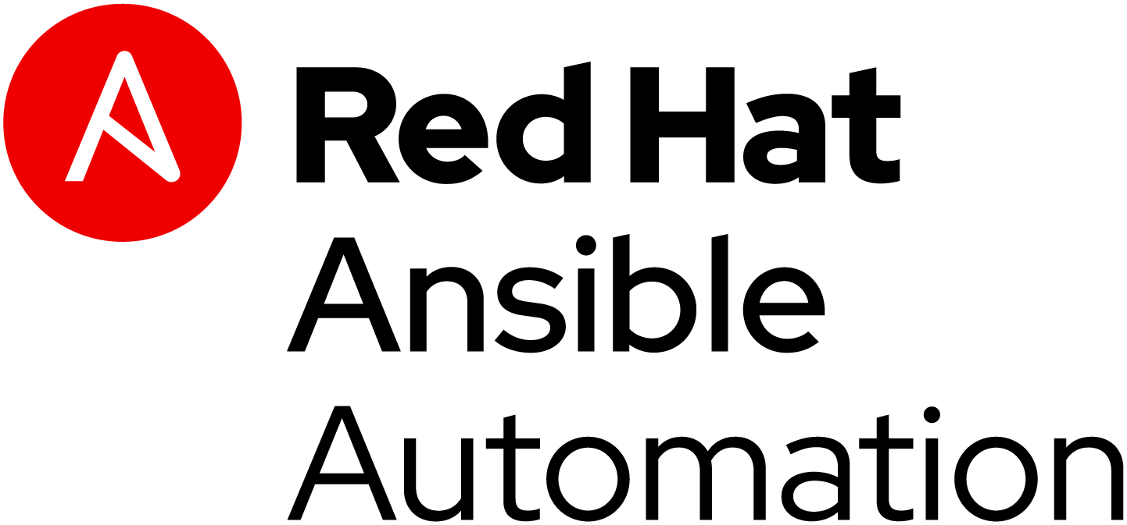

Red Hat Satellite - Upstream Evolution
Red Hat Satellite 5
Red Hat Satellite 6

